Slide 1

Nurse Burnout
&
COVID-19
Felisha Tune
NURS 6920
Fall 2021

Slide 2
Background
Nurse burnout has been an ongoing issue in healthcare. The COVID-19 pandemic has placed a strain on healthcare workers, especially those nurses working on the frontlines of COVID-19 inpatient units. Nurses are exposed to occupational hazards, high levels of stress and forced to work with limited resources such as staffing and personal protection equipment.
This puts nurses at a higher risk of suffering from physical, emotional and psychological burnout.

Slide 3
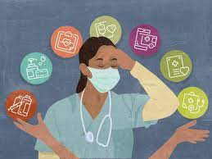
Background/Research Question
What is the level of burnout among nurses working on COVID-19 units in the hospital setting?

Slide 4
Review of Literature
Determination of Stress, Depression and Burnout Levels of Front-line Nurses During the COVID-19 Pandemic
  Authors: Merve Murat MSN, RN, Selmin Kose PhD, RN, Sevim Savaser PhD,RN
The Threat of COVID-19 and its Influence on Nursing Staff Burnout
  Authors: Guadalupe Manzano Garcia, Juan Carlos Ayala Calvo
The Exacerbation of Burnout During COVID-19: A Major Concern for Nurse Safety
  Author: Jacqueline Ross, PhD, RN, CPAN

Slide 5
Review of Literature
The literature examines how the COVID-19 pandemic has exacerbated the burnout phenomenon in nursing.
Social support from nurse leadership is shown to be an important intervention with combating nurse burnout
The mental, social and physical health of nurses suffering from burnout is discussed
The literature considers that there are several driving factors that contribute to nurse burnout during the pandemic

Slide 6
Methodology
Simple descriptive research design was used to conduct this study on the levels of burnout experienced by nurses working on COVID-19 units.
The Burnout Self Test Assessment is an adaptation of the Maslach Burnout Inventory was the instrument used to obtain data.
The participants consisted of nurses that currently or have previously provided direct care to patients on COVID-19 units within the hospital inpatient setting.

Slide 7
Methodology
Prior to conducting research, an IRB application was completed and submitted.
Explained in detail how data will be collected and securely stored.
Utilized Google Docs to administer survey questions
Informed consent
Demographic and survey questions required mandatory responses

Slide 8
Demographic Data
95% female
60% held a Bachelor of Science Nursing degree
50% had 5-10 years of work experience
57.5 % were employed as full-time staff nurses

Slide 9

Burnout Self-Test Assessment Categories
Emotional exhaustion- the feeling of not being able to give anything to others on an emotional level
Personal accomplishment- a negative work-related self-evaluation
Depersonalization- an excessively detached attitude towards patients and low personal accomplishment/a negative work-related self-evaluation

Slide 10

Burnout Self-Test Assessment
This self assessment tool is a valid instrument created by Mind Tools (mindtools.com)
15 statements
Not at all, Rarely, Sometimes, Often, Very Often

Slide 11

Presentation of Data- Emotional Exhaustion
“I feel run down and drained of physical or emotional energy.” 35% of nurses from the sample population agreed they felt this way very often.

Slide 12
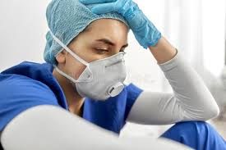
Presentation of Data- Personal Accomplishment
“I feel that I am achieving less than I should” showed a result of 50% of the sample population feeling this way sometimes.

Slide 13
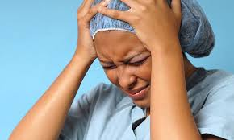
Presentation of Data- Depersonalization
40% agreed to the statement “I feel that organizational politics or bureaucracy frustrate my ability to do a good job” very often.

Slide 14
Theoretical Framework
Myra Levine’s Conservation Model of Nursing Theory.
the need for individuals to have a balance and a constant renewal of energy to maintain life activities.
Levine’s model describes conservation as a natural law that allows complex systems to continue to function even when they are severely challenged
For nurses to function in a healthy productive manner energy renewal must take place, interventions must occur to allow for energy to support life functions, dynamic relationships must exist, and there must be a sense of self-worth and self-identity.

Slide 15
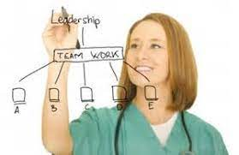
Suggestion for Future Nursing Research
Larger studies conducted over a longer timeframe
Limitations to this study included lack of male gender responses to the survey.
Conducting a follow-up survey to note any changes in the level of burnout overtime.

Slide 16
Recommendations for Nursing Leadership
Workplace empowerment
Training for nursing leadership to recognize nurse burnout at early stages to prevent it from progressing.
Allow nurses to self-schedule
Consider the use non-clinical staff to carry out non-nursing tasks to reduce the burden of the nurse’s workload
Recognition from leadership and peers

Slide 17

Thank You
Questions
Or Comments?

