Slide 1

Recruiting &
Hiring 101:
What You Need to Know

Slide 2
Today’s Agenda
The Request to Advertise
The Interview
The Hiring Proposal
Job Offer
Human Resources

Slide 3
Request to Advertise
Step One
    Documents to complete
      Critical Hire Form
      Questions to Advertise and
      Hire – Section 1
Human Resources

Slide 4
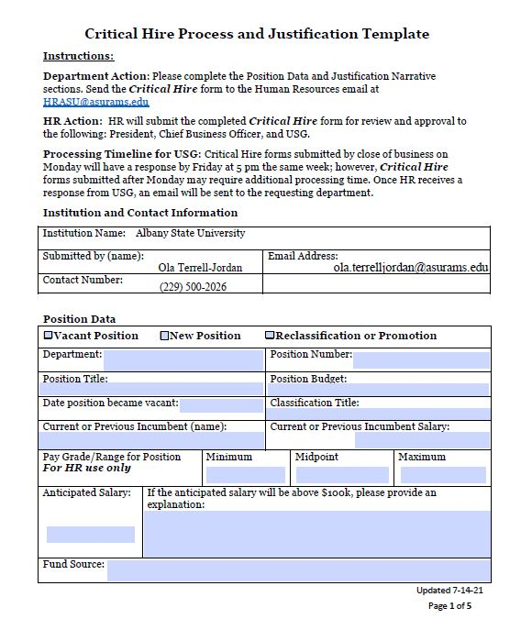
Critical Hire Page One
Complete everything
Contact HR for missing information
Contact Budgets for your budget information
It is imperative to complete all of the information on this page
Human Resources

Slide 5
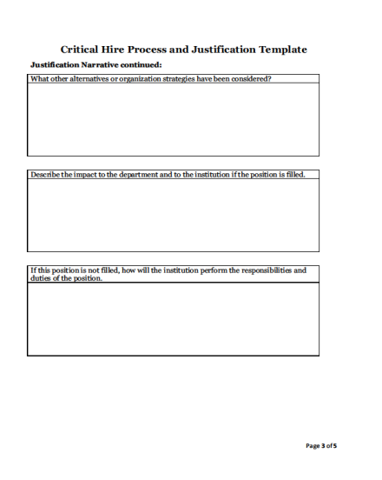
Remember to complete all sections of each page
Critical Hire
Pages Two
& Three
Human Resources

Slide 6
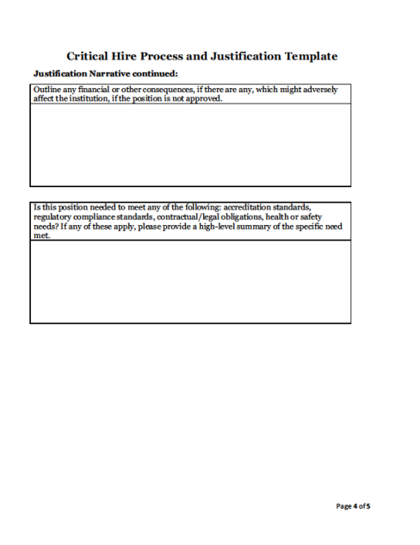
Critical Hire
Page Four
Remember to complete all sections of each page
Human Resources

Slide 7
Critical Hire
Page Five
All signatures are needed before HR can process the request.
The Hiring Manager, Department Head/Dean, VP, Title III, if needed, and Budgets
Human Resources

Slide 8
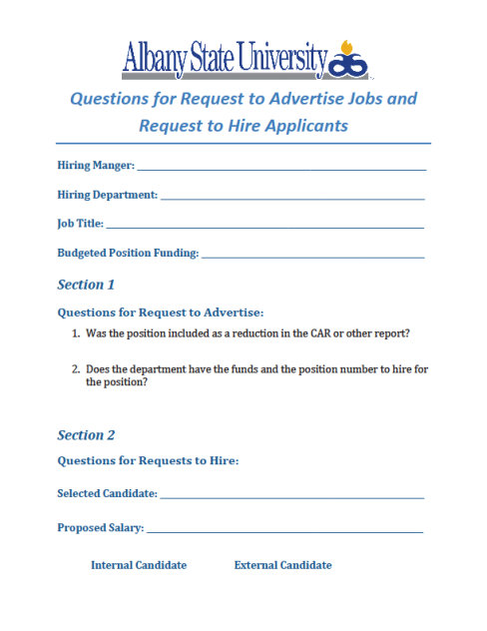
Questions to Advertise
Complete the top portion of the page and Section 1
Human Resources

Slide 9
Request to Advertise cont.
Step Two
    Documents to gather
    Organizational Chart
    Position Description
    Copy of the Grant for Grant
    positions (if applicable)
Human Resources

Slide 10
Request to Advertise cont.
Step Three
Send the documents to the supervisor and VP for signatures
Step Four
Budgets / Title III will validate the funding and send to HR
Human Resources

Slide 11
Request to Advertise cont.
Step Five
    HR will review your advertising request with the ASU Critical Hire Team
Human Resources

Slide 12
Request to Advertise cont.
Step Six
Approval: The hiring manager is notified the request to advertise was approved.
Disapproval : The hiring manager is notified and provided the reasons for the disapproval.
Human Resources

Slide 13
Job Posting
HR posts the job to the ASU Careers Webpage and selected external sites*
    *Hiring department is responsible for external
    posting costs
Hiring Manager notified when job is posted and receives qualifications checklist.
Human Resources

Slide 14
Interviewing: The Basics
Use the Qualifications Checklist to identify the applicants that applied and qualify for the job
Interview at least 3 qualified candidates
If 3 are not available to interview
    Interview available candidates
    Contact HR to assess the job posting
        Revise the ad
        Evaluate outside posting possibilities
Conduct interviews
Complete the Interview Summary Form and the rest of the Questions for Advertising and Hiring
Human Resources

Slide 15
Interview Summary Form
Step One
Complete the form with a high level recap of the candidate.
Do not just put Qualified!
If you interview more than four candidates, complete another form.
Human Resources

Slide 16
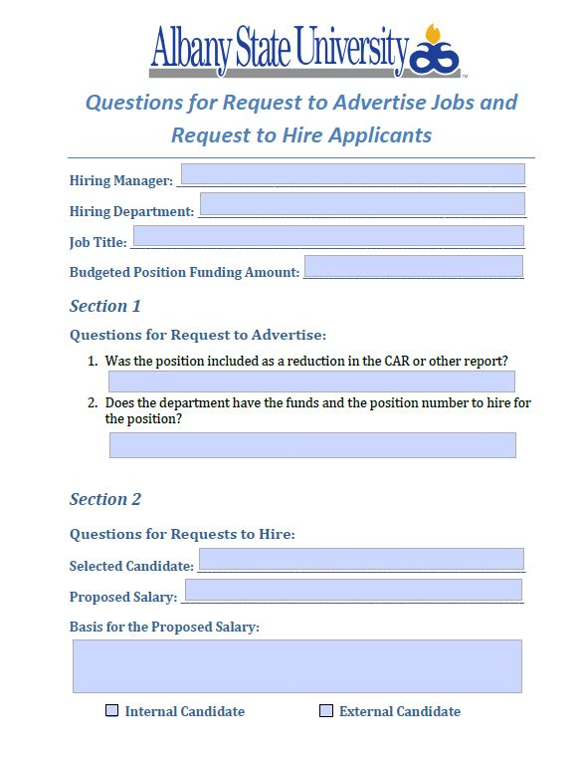
Request to Hire
Step Two
Go back to the Questions to Advertise/ Hire form and complete section 2.
Do not answer with just Qualified!
Human Resources

Slide 17
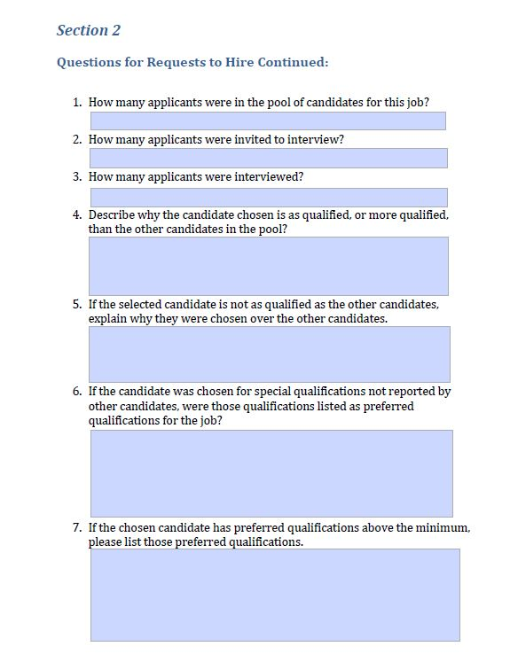
Request to Hire cont.
Section 2 cont.
Briefly answer the questions that apply.
Do not answer with just Qualified!
Human Resources

Slide 18
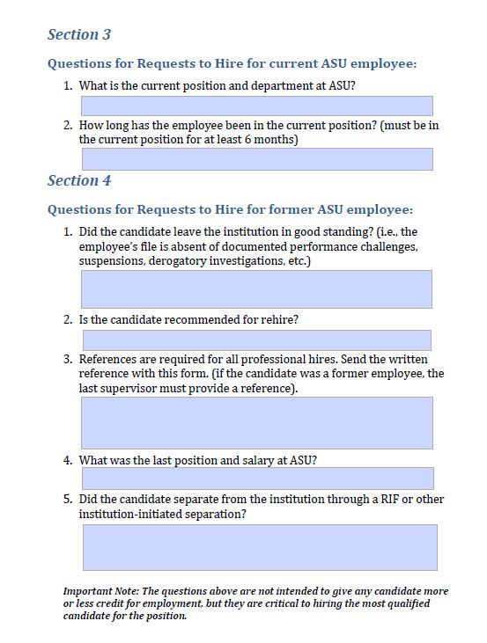
Request to Hire cont.
Complete section 3 if the applicant is a current ASU employee.
Complete section 4 if the applicant was a prior ASU / Darton employee.
For current and prior employees do not leave any space blank.
Human Resources

Slide 19
Request to Hire cont.
Step Three
Send completed forms to HR
  Interview Summary
  Questions to Advertise and Hire
Submit the forms to HRASU@asurams.edu
The subject line should read ‘Critical Hire – Request to hire’
Human Resources

Slide 20
Request to Hire cont.
Step Four
  The HR review
  The documents submitted will be vetted
  The applicant’s resume will be assessed using the Qualifications Checklist
  Qualified – HR will send to ASU Critical Hire Team
  Not Qualified – Hiring manager is contacted for more information or the possibility of the hire proposal being canceled.
Human Resources

Slide 21
Request to Hire cont.
Step Five
  The Committee Approves:
    Hiring manager is notified
  The Committee Disapproves:
    Hiring manager is notified and reasons provided
Human Resources

Slide 22
Job Offer Process
Making the offer
  Contingent job offer is made
    Staff offers made by HR both verbal and written offers
    Faculty offers are made by Academic Affairs after HR has notified them of the approval.
Human Resources

Slide 23
Job Offer Process cont.
Offer Accepted
HR initiates the Background check
    *Background check is done on all
    new hires and rerun on anyone
    separated a year or longer
Successful Background checks – New hire paperwork is sent
Human Resources

Slide 24
Job Offer Process cont.
Unsuccessful Background checks- pre-adverse letters are sent
  The candidate has the opportunity to respond to the background check.
The response is reviewed
  Accepted – the new hire paperwork is sent
  Declined – the job offer is rescinded and the hiring manager is notified
Human Resources

Slide 25
Job Closure
The job is removed from the web when a hiring proposal is submitted to HR.
  This prevents any further applicants from applying for the job
  It does not close the job. It still shows open to the hiring manager.
Once the applicant is hired into the positon, the job will automatically close
Human Resources

Slide 26
Questions?
Human Resources

