Slide 1
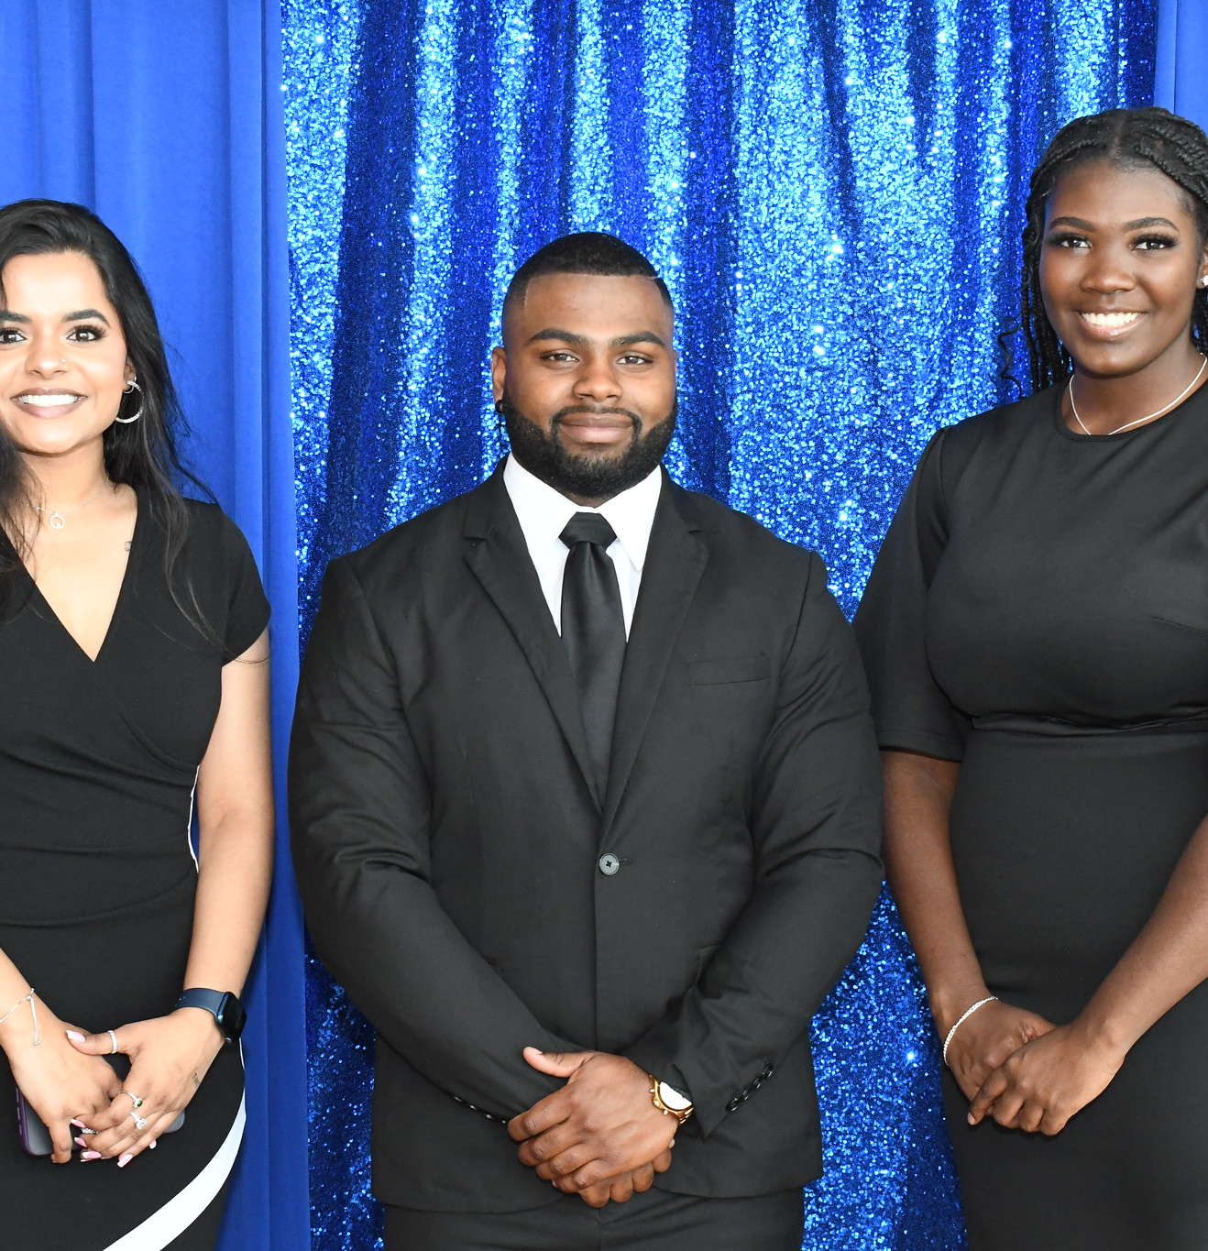
2023-2024
Registered Student
Organizations

Slide 2
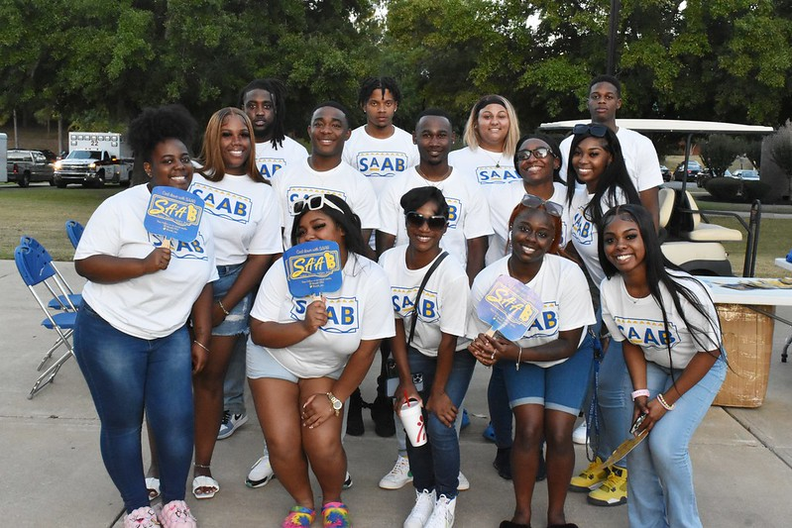
Student Activities Advisory Board
SAAB
Alias:
Chartered at ASU:
Current President:
Current Advisor (s):
Mission:
Signature Events:
Membership Requirements:
Keep Up With Us:
1903
Jade Woodard
Venessa McKinney, Brian Covington
The Student Activities Advisory Board at Albany State University is a branch of the Office of Student Engagement. Its mission is to provide cultural, social, civic and recreational outlets for the student body. This group also complements those educational goals and values of the University and the Office of Student Engagement.
Buck Back Weeks, Homecoming, Student Appreciation Week
SAAB hosts information sessions twice an academic year. SAAB elects to accepts members on an as needed basis. At minimum candidates for membership should possess at 3.0 GPA on all coursework and be in good standing with the university.
@SAAB1903 on Instagram
Registered Student Organizations

Slide 3
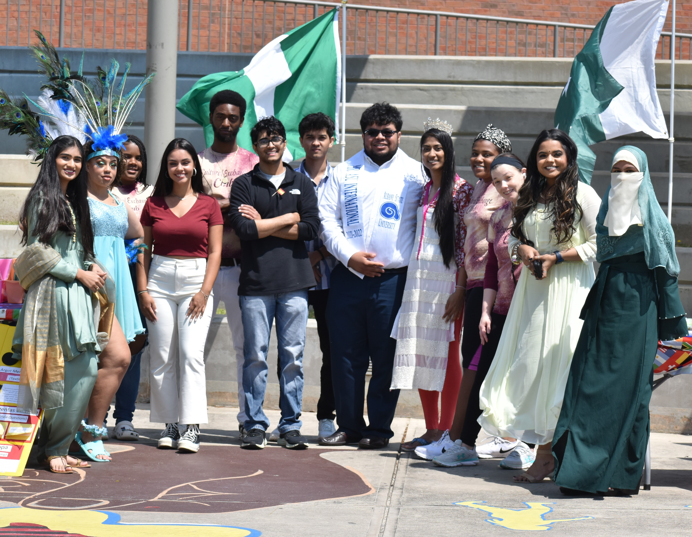
Cultural Exchange Club
Alias: CEC
Chartered at ASU: 2021 Current President: Carla Sorroche Suarez
Current Advisor: Dr. Annalease Gibson
Mission: To promote understanding, appreciation, and celebration of Cultural Diversity through engaging activities, events, and initiatives, fostering meaningful connections, and empowering members with the knowledge and skills needed to navigate an increasingly diverse global landscape.
Signature Events: International Education Week, Spring Fling
Membership Requirements: Must be enrolled as undergraduate or graduate student. Attend majority of club events and activities held throughout the academic year.
Keep Up With Us: @asu_cultural_exchange
Registered Student Organizations

Slide 4
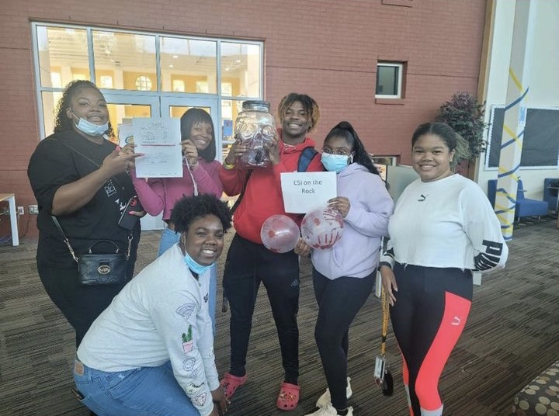
Forensic Science Club
Alias: FSC
Chartered at ASU: 2014
Current President: Evelyn Redmond
Current Advisor (s): Dr. Uzoma Okafor
Mission:
The mission of the Forensic Science Club is to function as a catalyst for students and professionals of forensic science. The activities of the Club shall be designed to stimulate academic achievement, advance the fields of forensic science, promote community understanding, and promote diversity. Undergraduate and graduate students of sound scholarship and character who support this mission may be elected to membership.
Signature Events: Paint 'N Sip, Spring Bake Sale
Membership Requirements: Must be an undergraduate or graduate student at ASU with at least a 2.5 GPA (undergrad) or a 3.0 GPA (grad). Also, must be majoring in forensic science or a natural science program.
Keep Up With Us: @forsciclubasu /Instagram
Registered Student Organizations

Slide 5
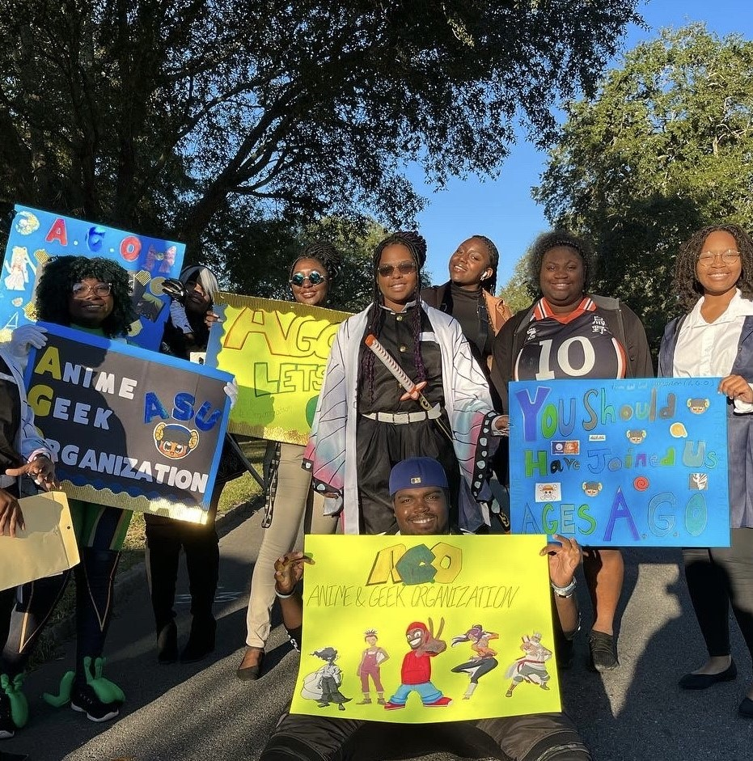
Anime and Geek Organization
Alias: A.G.O , Anime Club
Chartered at ASU: 2021
Current President: Sherrmitria Garrett
Current Advisor (s): Dr. Richard J. Mason
Mission: Our mission is to foster a wholesome community for those with an interest in animated and comic media to develop friendships and connections and to erode barriers related to social identity.
Signature Events: A.G.O CON , Gaming Tournaments , Movie nights
Membership Requirements: Completion of membership form each semester , Maintain a 2.0 gpa on the 4.0 scale and compliance with the constitution and campus guidelines.
Keep Up With Us: Instagram , Twitter , TikTok @ ago_asu
Registered Student Organizations

Slide 6
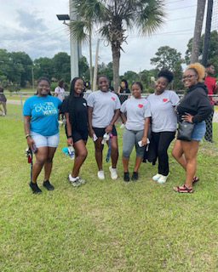
Teaching Educators and Creating Heritage
Alias: T.E.A.C.H
Chartered at ASU: 2021
Current President: Rachel Robinson
Current Advisor (s): Bettie Stafford , Tiffany Pogue
Mission: The T.E.A.C.H. Mission is to help students develop professionally in specific alignment with dispositions reflective of national teaching organizations while serving the local community in service. We strive to network and develop new connections with our peers, professors, university, and community for the betterment of the future of our youth.
Signature Events: Spelling bee , Teach Week
Membership Requirements: Completion for membership each semester. Must either be a full time or parttime student. Who maintains a 2.5 gpa on the 4.0 scale. Also, all majors are welcome!
Keep Up With Us: Instagram: @teachasurams
Registered Student Organizations

Slide 7
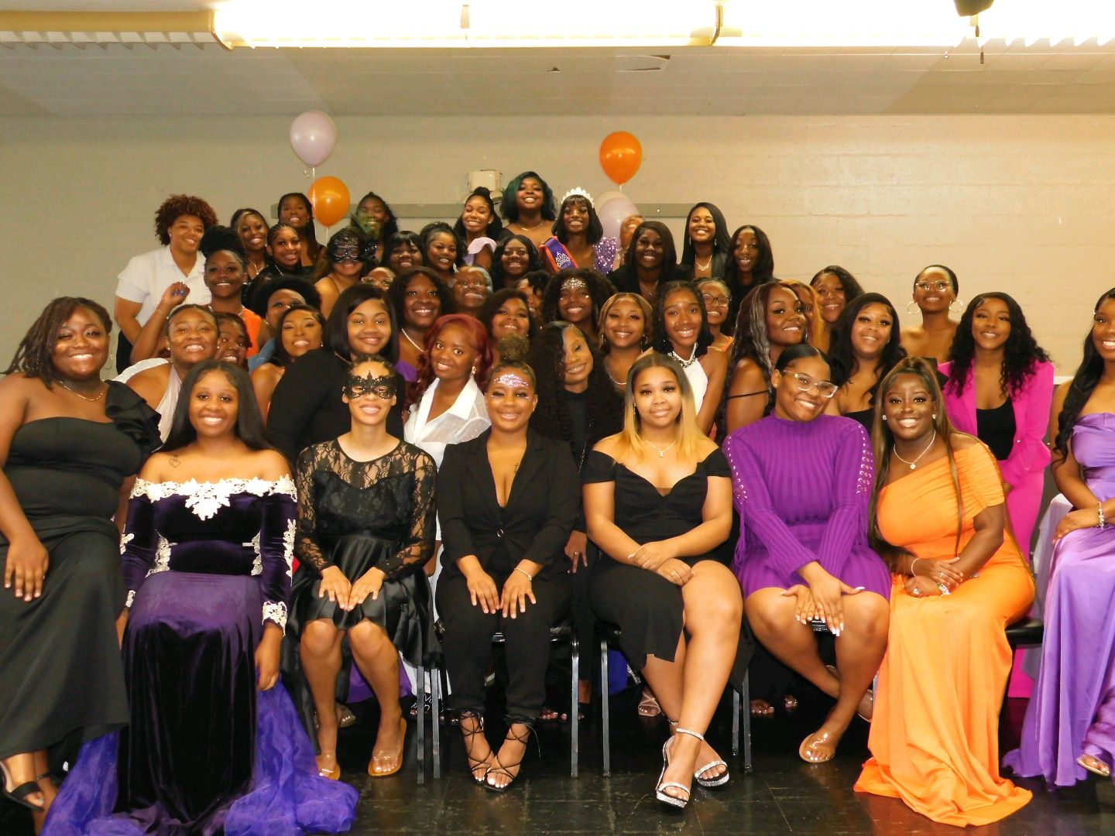
National Council of Negro Women Inc.
Alias: NCNW
Chartered at ASU: 2020
Current President: Ayanna Mitchell
Current Advisor (s): Mrs. Heppard-Streeter
Mission: Our mission to lead, advocate for and empower women of African descent, their families and communities.
Signature Events: Purple Table Talks
Membership Requirements: Students must be enrolled as an Albany state university student. Students should also be in good academic standing with the university. Member should be willing to give back to our communities and campus.
Keep Up With Us: Instagram: asu.ncnw Email: ncnwasu@gmail.com
Registered Student Organizations

Slide 8
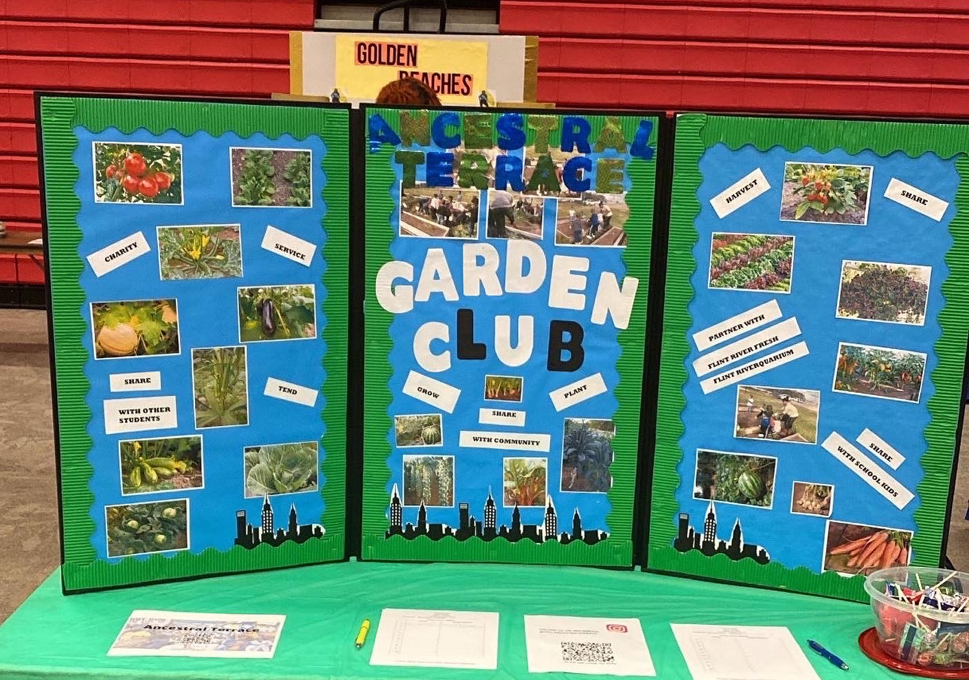
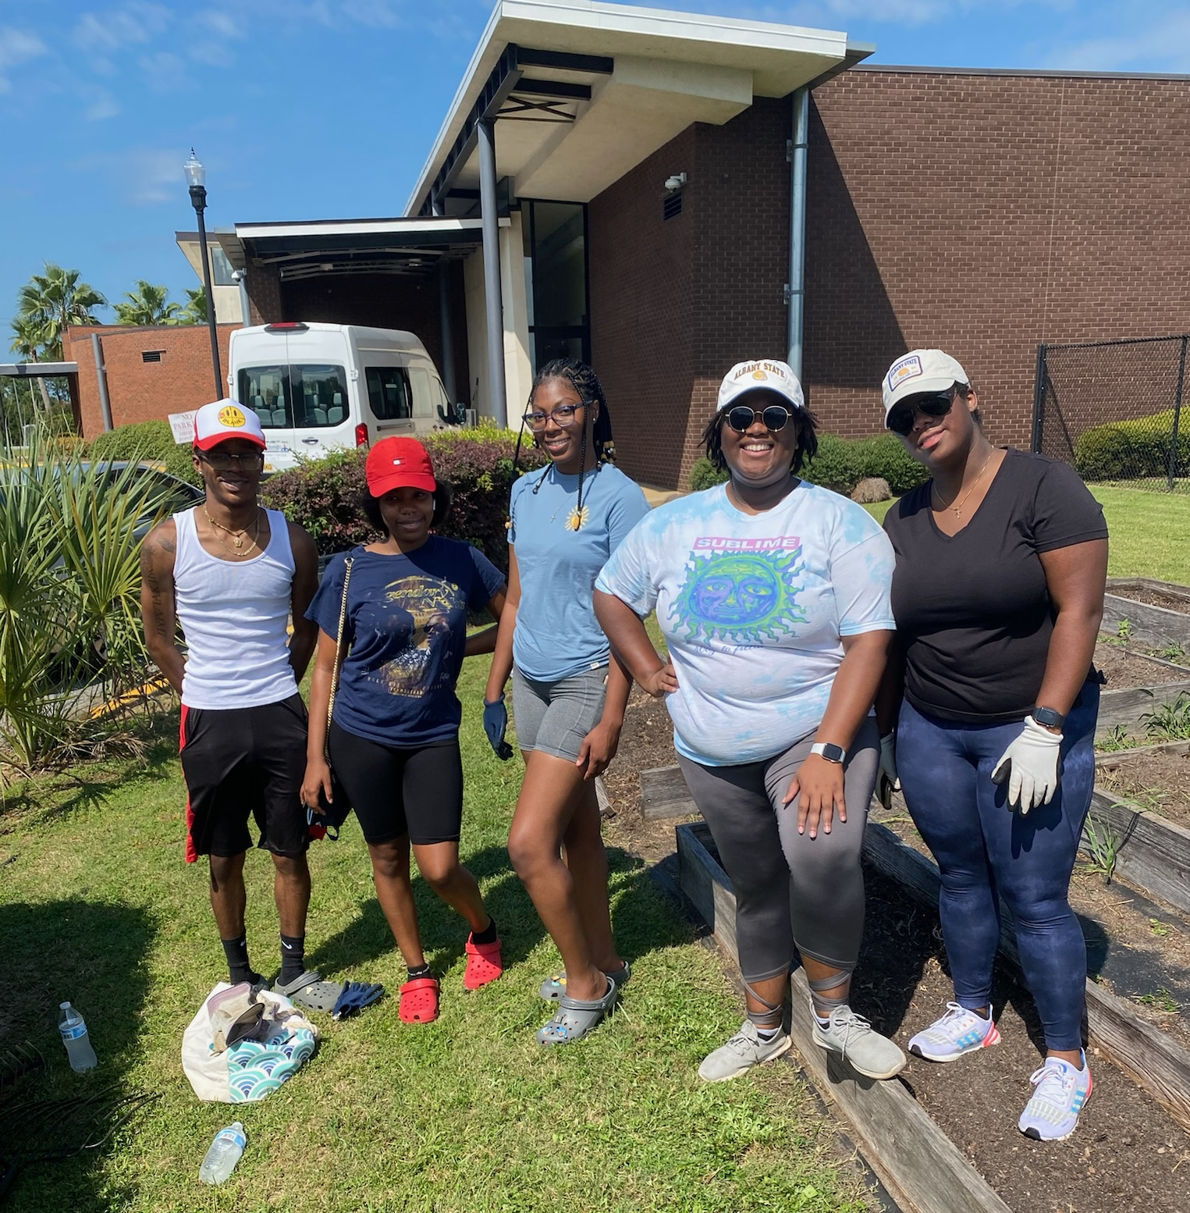
Ancestral Terrace
Alias: Garden Club
Chartered at ASU:
Current President: Jasmine Pritchett
Current Advisor (s): Richard Foreman
Mission:
and to restore, improve and protect the quality of the environment through educational programs and action in the fields of conservation and civic improvement
Signature Events: Paint party , Community Service with Flint River Fresh , garden bed clean up
Membership Requirements:
Keep Up With Us: Follow us on Instagram @asu.ancestralterrace
Registered Student Organizations

Slide 9
The Golden Peaches
Alias: Golden Peaches, GP
Chartered at ASU: 2021
Current President: Khalia Johnson
Current Advisor (s): Trayondus Baynard, Quenton Matthews
Mission: Our mission is to serve as Classy, Curvy, Confident women and encourage and empower other women on campus through dance, community service, sisterhood, and service.
Signature Events: Peachy Night, Golden X-Perience
Membership Requirements: Students must be currently enrolled and in good standing with the university, at least a 2.5 GPA, and be willing to learn and work hard.
Keep Up With Us: Instagram: @asu.golden.peaches
Registered Student Organizations

Slide 10
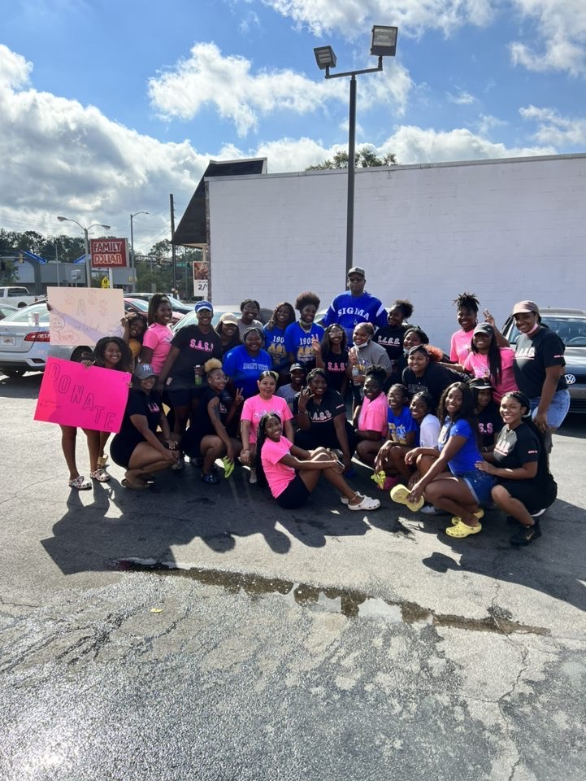
Student's Advocating For A Stronger Sisterhood
Alias: S.A.S.S.
Chartered at ASU:
Chartered on Albany State’s campus by Candice Edwards in 2010.
Current President: Isis Jenkins
Current Advisor (s): Kimberly R. Burgess
Mission: Empowering and enriching young women while building stronger character and sisterhood throughout the campus and community while empowering the world.
Signature Events: Chills & Thrills/ Art In Motion / Sassy Sweets
Membership Requirements:
Good standing as is described as:
Maintained an overall GPA of 2.00
Keep Up With Us: IG: @sassasu.1903 / EMAIL Asusass1903@gmail.com
Registered Student Organizations

Slide 11
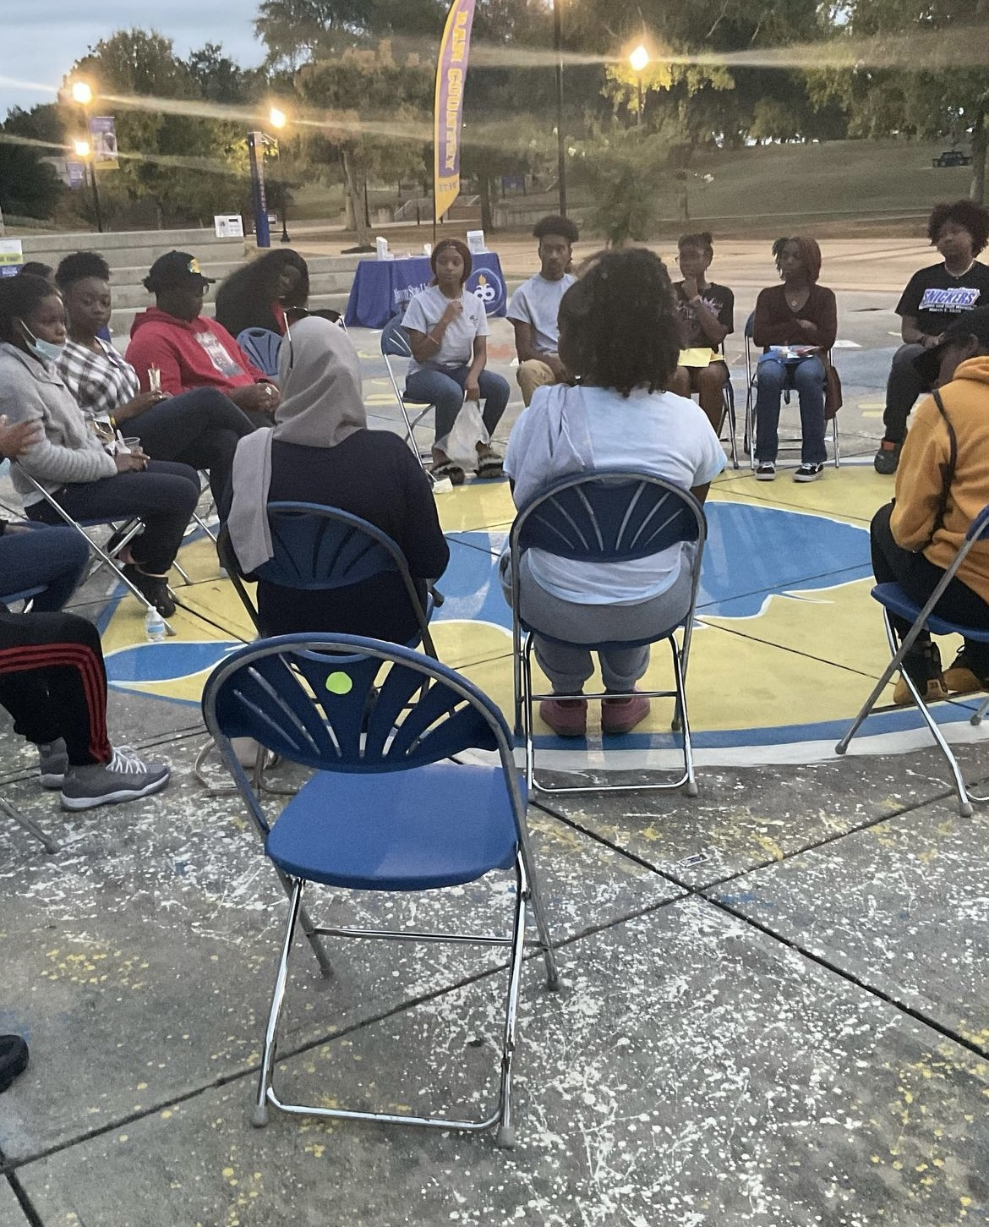
The Psychology Club
Alias: Psych Club
Chartered at ASU:
Current President: Niamya Johnson
Current Advisor (s): Malisha Mishoe
Mission: To create an environment conducive to cultivating new relationships all while providing unique and educational social events geared toward increasing knowledge in the field of Psychology.
Signature Events: Debate Night, Release the Mind Event, Freshman Basketball Tournament
Membership Requirements:
Must have a 2.0 GPA, Must have taken 1 Psychology Course, Must be able to attend General Meetings and Events held throughout the academic school year.
Keep Up With Us: @asu.psychologyclub
Registered Student Organizations

Slide 12
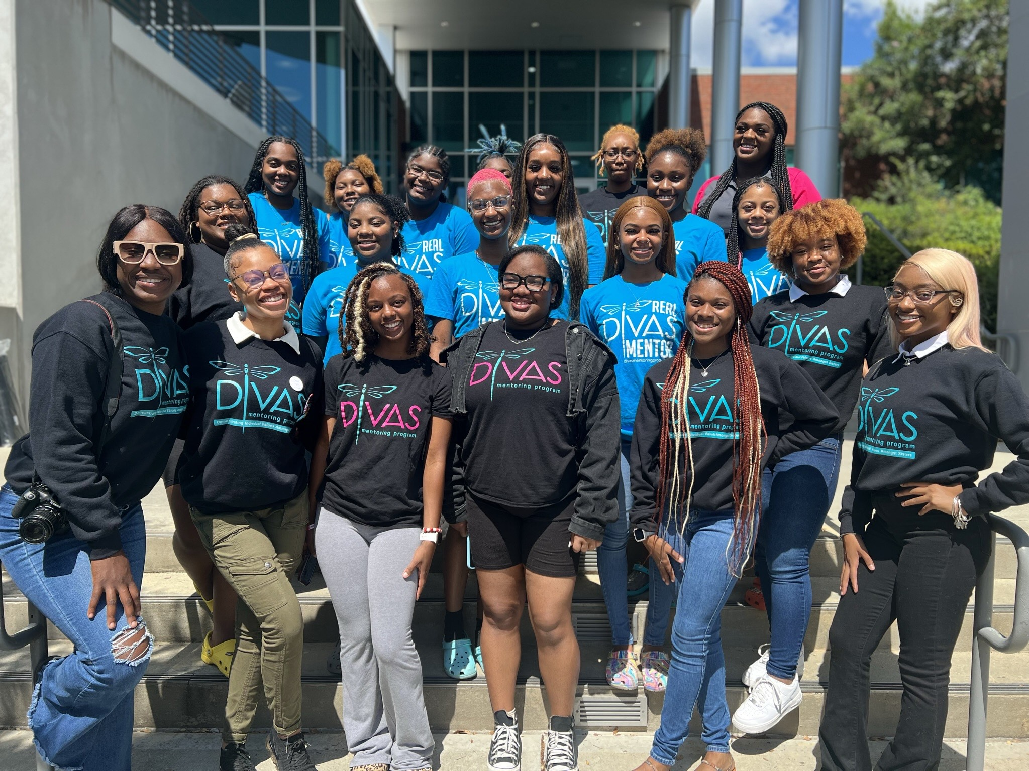
Alias: D.I.V.A.S. Mentoring Program
Chartered at ASU: 2009
Current President: Nahja' Schaffer
Current Advisor (s): Dorene Medlin
Mission: To provide a safe and comfortable platform for young ladies to share life’s experiences while fostering sisterhood and promoting social and academic excellence, by way of humanitarian efforts.
Signature Events: Headshots with Divas, Spread the Love-Feed the Hungry, Kickball Tournaments, and Stash the Trash
Membership Requirements: To be eligible for membership into D.I.V.A.S, candidates must have a minimum of 9 credit hours and be in good standing with the Institution. Students must have and maintain a minimum of 2.8 GPA in order to become and remain a member of D.I.V.A.S.
Keep Up With Us: Find us on Instagram @Divasmentoringprogram_ !!
Registered Student Organizations

Slide 13
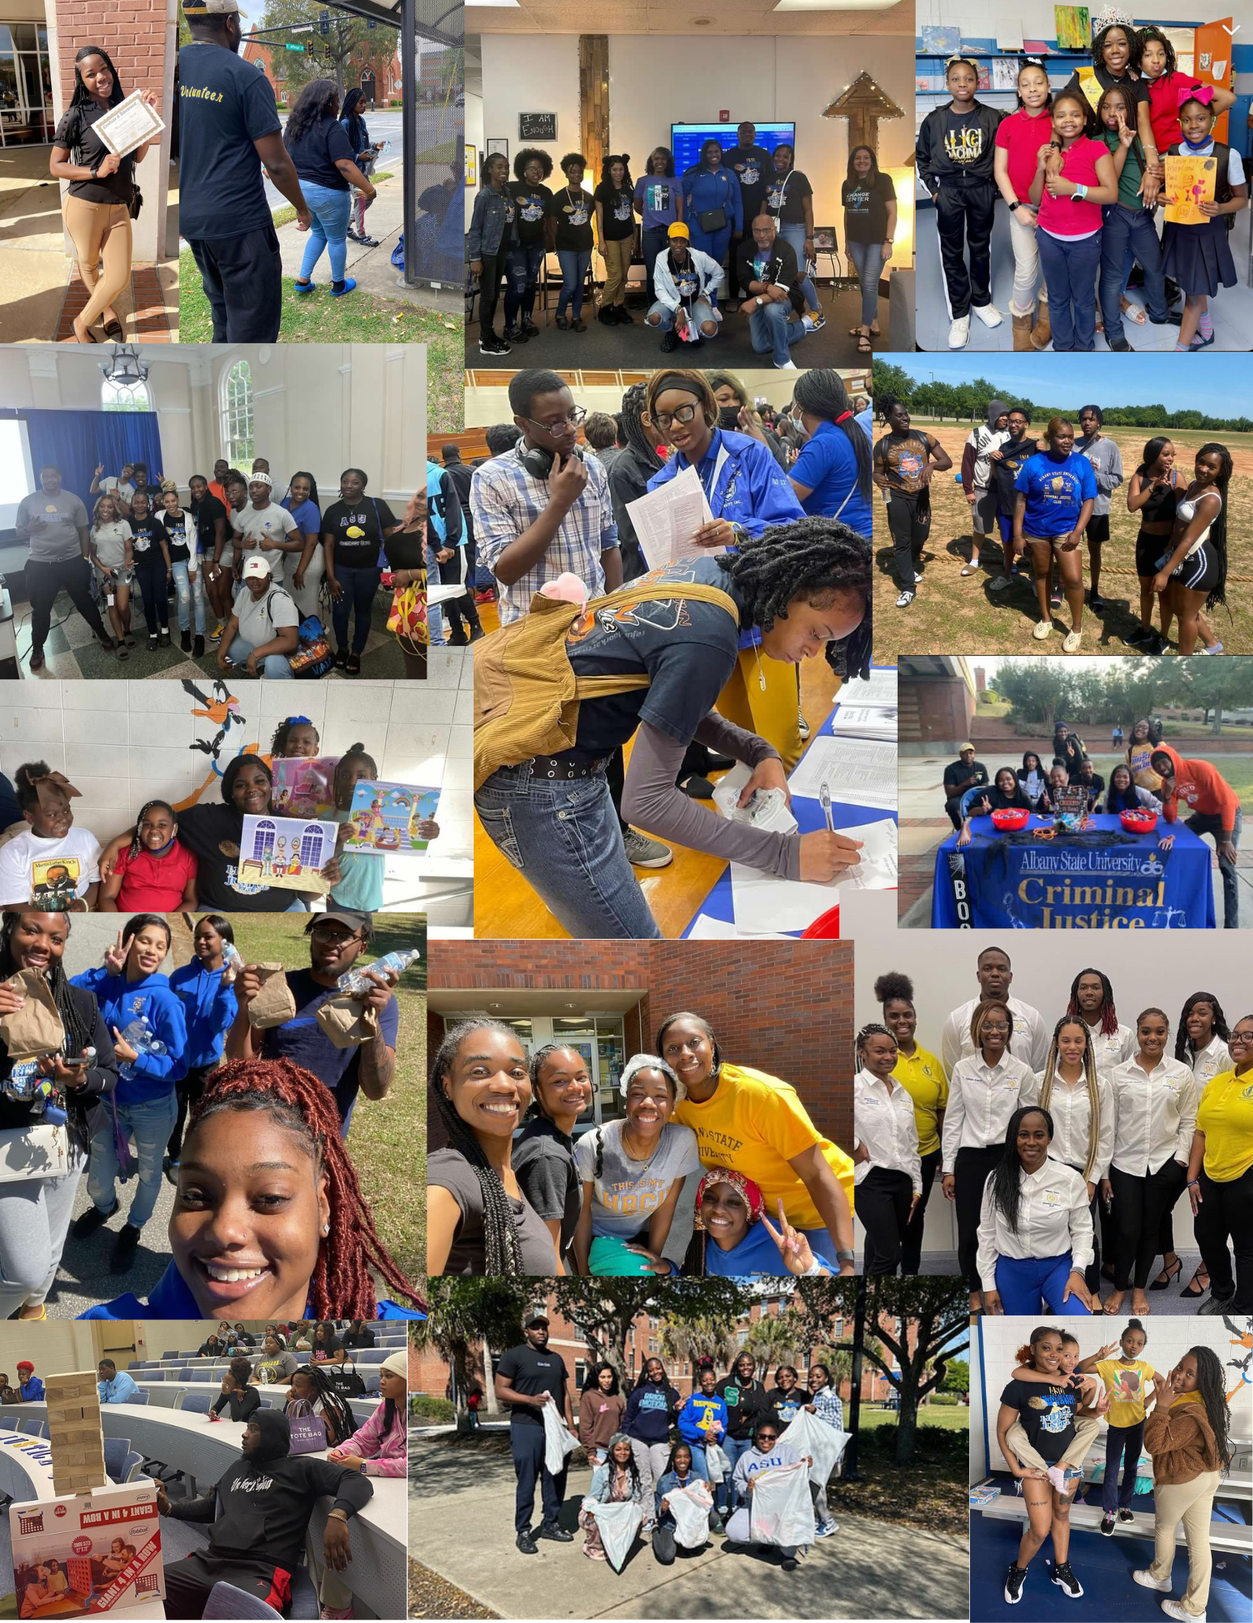
Criminal Justice Club
Chartered at ASU:
Current President: T'Aundria Everett
Current Advisor (s): Dr. Kizzie Donaldson-Richard
Mission: Albany State University's Criminal Justice Club promotes a positive academic attitude while providing an atmosphere conducive to learning and growth. We do this by emphasizing the critical importance of the Criminal Justice program that prepares students to become leaders, outstanding practitioners, scholars, and advocates for social justice in a diverse and global society. The Criminal Justice Club aims to connect students who seek entry-level and in-service professional criminal justice careers in federal, state, and local criminal justice agencies. We establish a network by helping students improve their academic success by providing them with services when needed. The fundamental mission of the Criminal Justice Club is to enable students to belong to an organization that will stimulate exceptional academic expectations and personal achievement and enhances engagement on/off campus and in the community. The programs emphasize academic quality and integrity, career advancement, technological innovation, the work-based paradigm, hands-on exposure to cutting-edge issues in criminal justice, commitment to students and citizens in its area, and dedication to program improvement. The Club strives to educate students for a positive impact on social change. The Criminal Justice Club aims to help students connect closely with elected and appointed officials to get a real-life experience of what their future/ potential job might require. Lastly, we will conduct at least one monthly meeting to have an open discussion to assess the needs and concerns of the Club members to ensure that everyone has a say in the direction that we would like our Club to operate.
Signature Events: FALL EVENT (HAUNTED HOUSE)
Membership Requirements: To be eligible all members must hold a 2.0 or higher gpa, members are encouraged to participate in all events or volunteer projects, and members will have to sign a letter with the bylaws.
Keep Up With Us: Twitter: ASU_CJClub, INSTAGRAM: asu_cjclub, Email:crjuclub1920@gmail.com
Insert Org. Logo
Insert Group/Event Photo
Registered Student Organizations

Slide 14
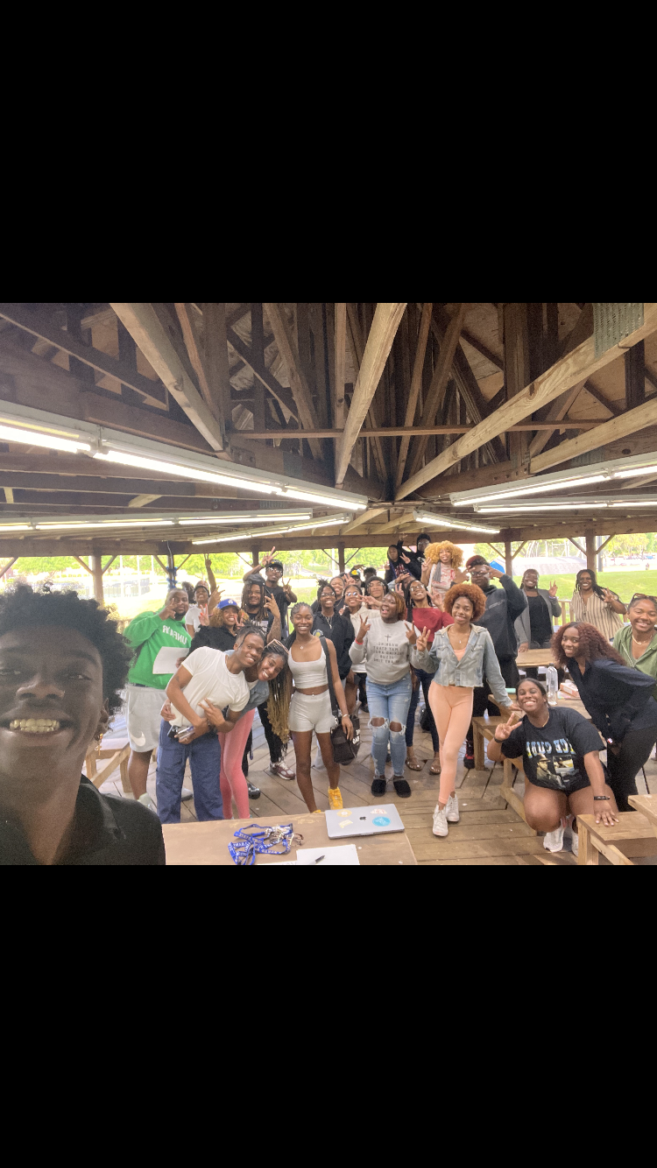
IGNITE FREEDOM
Insert Org. Logo
Alias: IGNITE Chartered at ASU: 2022 Current President: KAMARI WILLIAMS
Current Advisor (s): Cpt. Brian Covington Mission: Ignite ASU will encourage, influence, and ignite fire in people; encouraging them to be set apart and to be bold in whom God has called them to be. To connect people through fellowship who share a heart in beliefs in Our Lord and Savior Jesus Christ.
Signature Events: Prayer at the Chimney, Praise on the Yard, and Ignite the Fire Taco Night Membership Requirements:
Have a positive attitude, respect all other members, be able to show spiritual improvement/growth, maintain a 2.5 GPA or higher, maintain a well-kept social media presence
Keep Up With Us: add us on Instagram @igniteasu
Insert Group/Event Photo
Registered Student Organizations

Slide 15
Iota Eta Chapter of Alpha Phi Sigma
National Criminal Justice Honor Society
Alias: Alpha Phi Sigma
Re-Chartered at ASU: Spring 2023
Current President: Sydney Melton
Current Advisor (s): Dr. Robert Ausby & Dr. Lakesha Boone
Mission: The goals of Alpha Phi Sigma are to honor and promote academic excellence, community service, educational leadership, and unity.
Signature Events: TBA
Membership Requirements: Baccalaureate students shall be enrolled at the time of application in the institution represented by the chapter, have declared a major, minor or equivalent in the criminal justice or related field, have completed 45 semester hours, have a minimum GPA of 3.2 on a 4.0 scale, with a minimum GPA of 3.2 in courses in criminal justice related fields and rank in the top 35% of their class. A minimum of four courses of the above course work shall be in the criminal justice field. Students who completed an Associate degree in Criminal Justice and are currently enrolled in a bachelor’s program, with a minimum cumulative GPA of 3.2 on a 4.0 scale are eligible for membership.
Registered Student Organizations

Slide 16
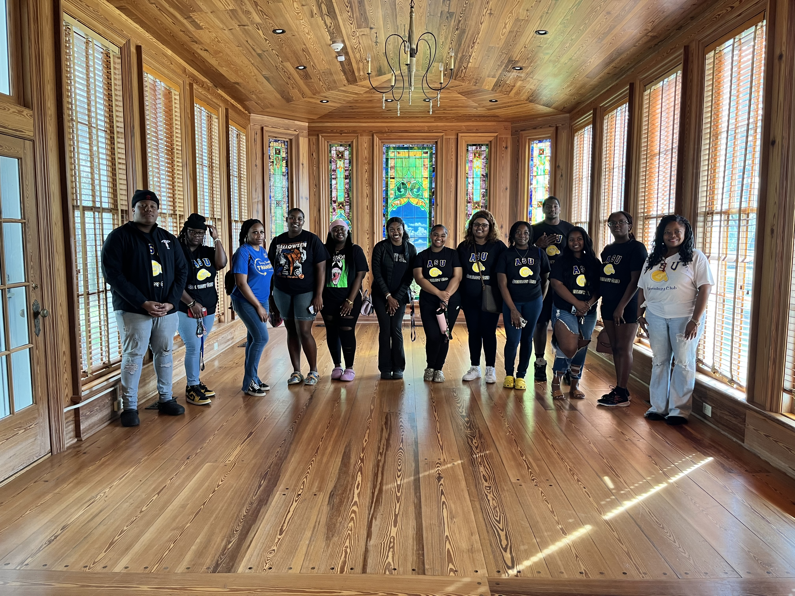
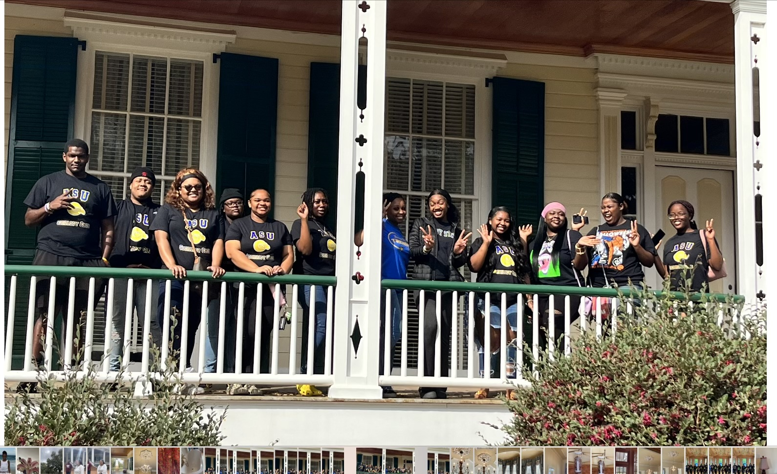
The Sociology Club
Current President: Na'Aeisha Brown
Current Advisor (s): Cassandra D. Jordan
Mission: The Sociology Club is to promote interest in The Sociology Department on the campus of Albany State University by providing our members with the initial tools to grow socially as well as academically.
Signature Events: Sociology Matters,
Bring it to the Table
Membership Requirements:
MUST be a full-tIme student
GPA 2.0 or better
All MAJORS are welcomed!
Keep Up With Us on IG: @asusociologyclub
Registered Student Organizations

Slide 17
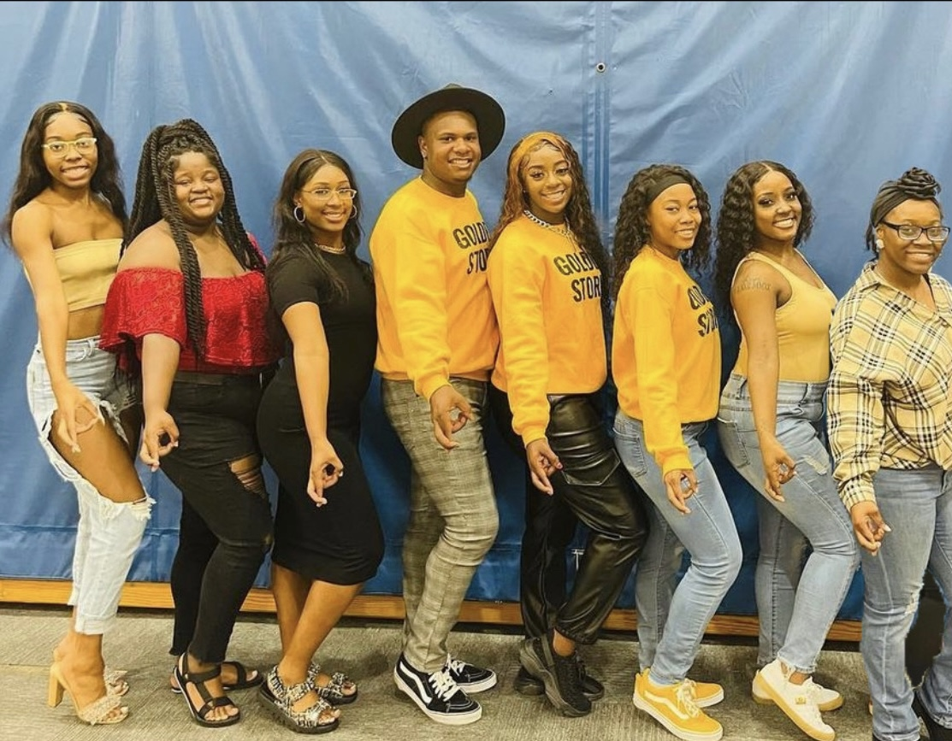
Golden Storm Dance Company
Alias: Golden Storm Dance Company (GSDC)
Chartered at ASU: 2022
Current President: J'Niya Hayes
Current Advisor (s): Kimberly McCulllough
Purpose & Mission:
Purpose: Our sole purpose is to provide dance entertainment at on and off campus and as requested school events. GSDC serves as a safe space for males who also share the common passion of dancing with females.
Mission: Our mission is to enhance and diversify our craft of dance equally as one!
Signature Events: Golden X-Perience
Membership Requirements: Enrolled student at ASU, 2.0 GPA or higher, 10 hours of community service.
Keep Up With Us: Instagram & Twitter- @asugoldenstorm, Email Us: @asugoldenstorm@gmail.com
Registered Student Organizations

Slide 18
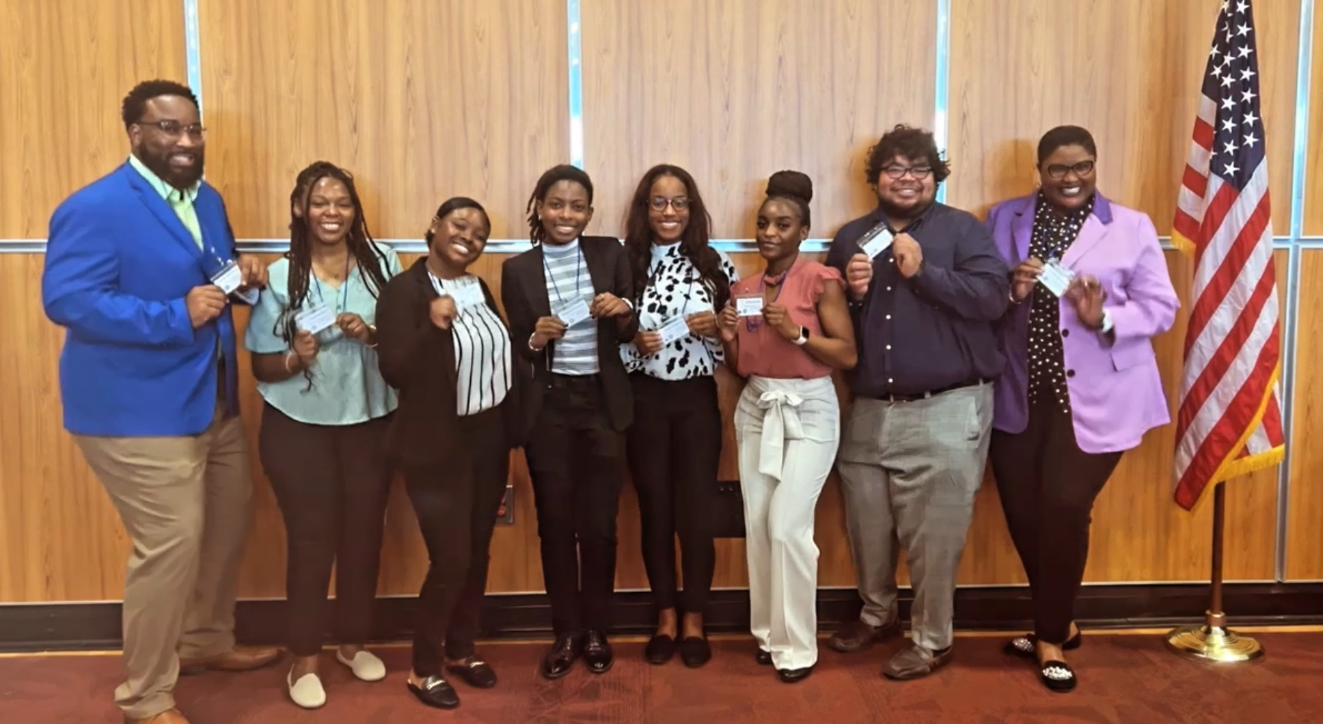
The Alpha Iota Chapter of Alpha Kappa Mu Honor Society
Alias: AKMu
Chartered at ASU: N/A
Current President: Bethany Jackson
Current Advisor (s): Dr. Kenya Lemon, Prof. Brandon Henry
Mission: The AKMu honor society serves to promote high scholarship achievement and prepare juniors and seniors for the furthering of their livelihood and scholarly endeavors
Signature Events: Campus Midterm Give Back, Toys 4 Tots
Membership Requirements: Scholars must be a junior or senior, with a 3.3 minimum GPA, and display leadership skills and good character
Keep Up With Us: Instagram & Twitter- akmu_1903, Website- alphakappamu.org
Registered Student Organizations

Slide 19
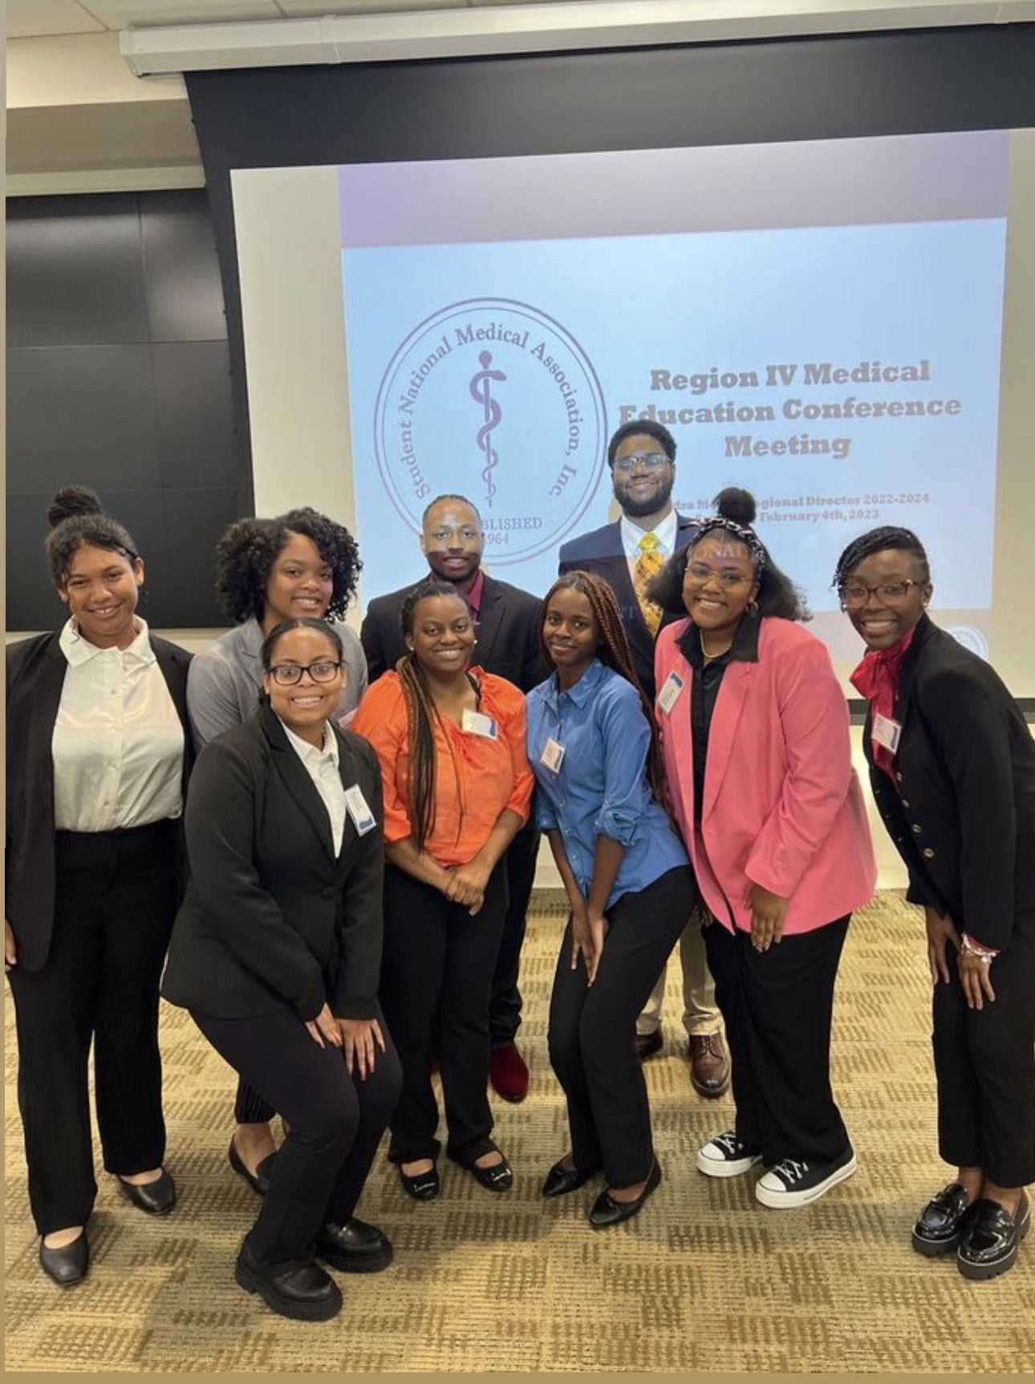
Minority Association of Premedical Students
Alias: MAPS
Chartered at ASU:
Current President: Sonya Whitaker
Current Advisor (s): Dr. John L. Williams
Mission:
The Minority Association of Premedical Students (MAPS) is committed to supporting current and future underrepresented minority medical students, addressing the needs of underserved communities, and increasing the number of clinically excellent, culturally competent and socially conscious physicians.
Signature Events: Health Fair Day: CPR training, Suture Event, and vitals training
Membership Requirements:
The Members of MAPS shall be any premedical student. Any undergraduate or graduate allied health student, health professions student or anyone who is interested in the mission and understands the purpose MAPS. Such membership shall be granted, upon payment of prescribed dues, to any student belonging to the aforementioned categories who recognizes the need for existence of the MAPS, and who believes in the ideas, aims and purposes upon which it was founded.
Keep Up With Us: @asu.maps on Instagram
Registered Student Organizations

Slide 20
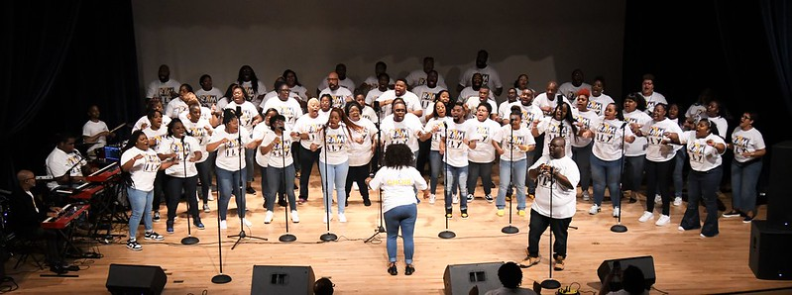
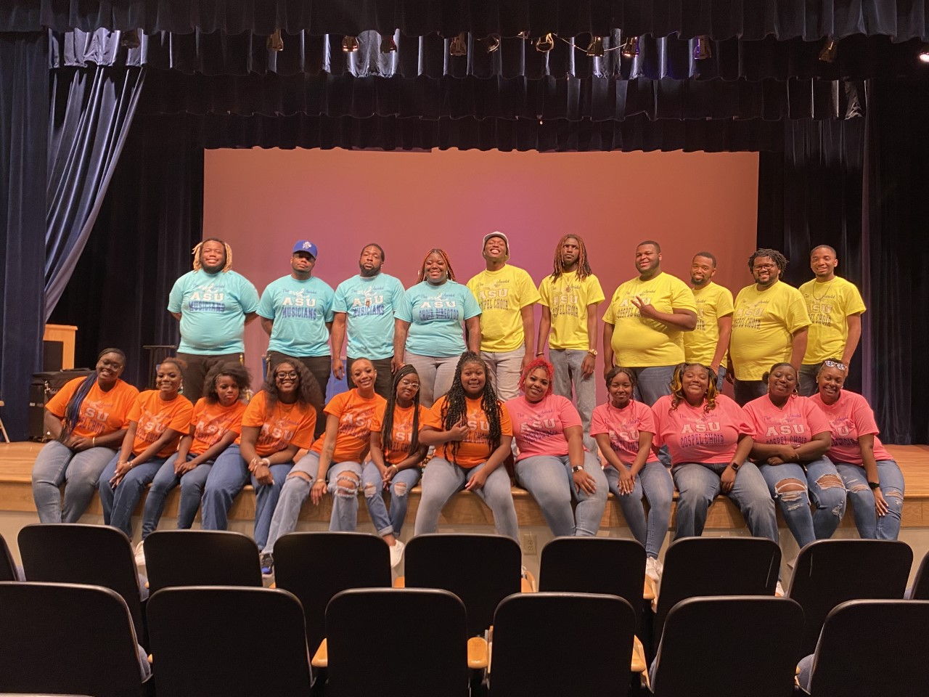
Thee Anointed Albany State University Gospel Choir
Alias: AASUGC
Chartered at ASU: September 1991
Current President: Michala Maddox
Current Advisor (s): James Brown
Mission: The organization's purpose shall be to train singers, musicians, directors, and leaders while also serving as a source of encouragement to the university campus as well as the Albany Community.
Signature Events: RAMspiration, Homecoming Gospel Explosion, Fall Concert, Spring Concert
Membership Requirements: To be a member of the Anointed ASU Gospel Choir, you will need higher than a 2.5. If you receive a 2.5 during your time in the choir, you will have a semester to get that 2.5 up or you will be dismissed from the choir. Before becoming official members, each interested student must audition and make it through the audition process.
Keep Up With Us: @theeanointedasugospelchoir
Registered Student Organizations

Slide 21
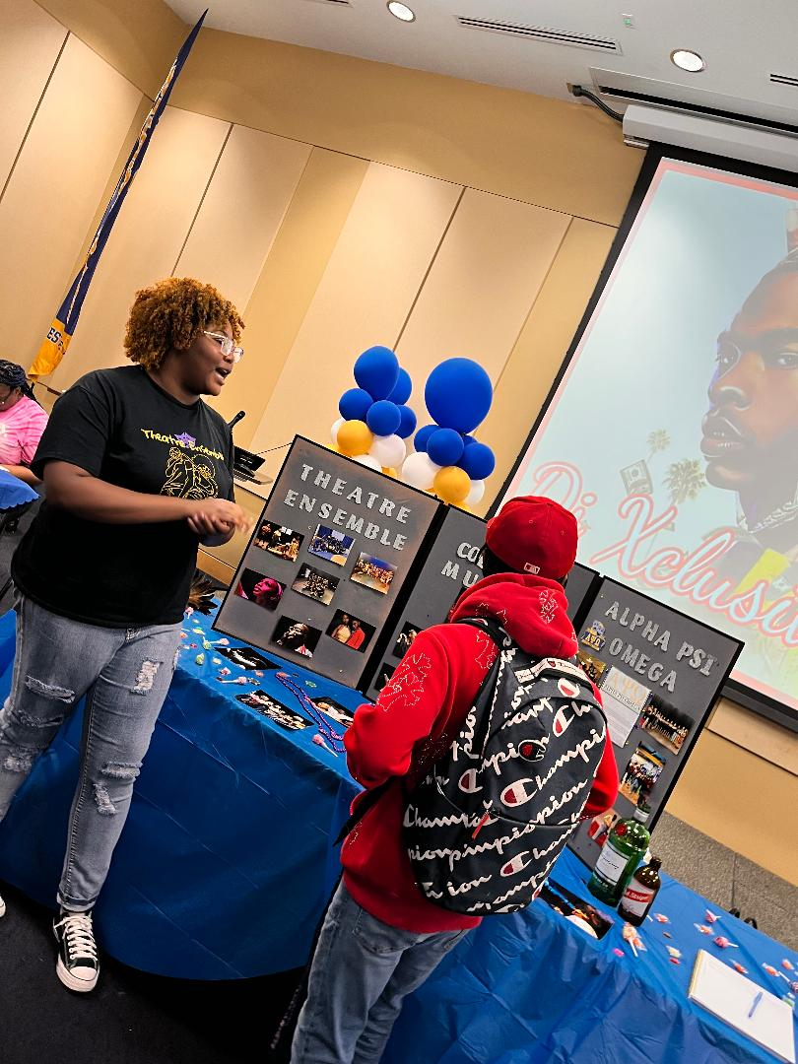
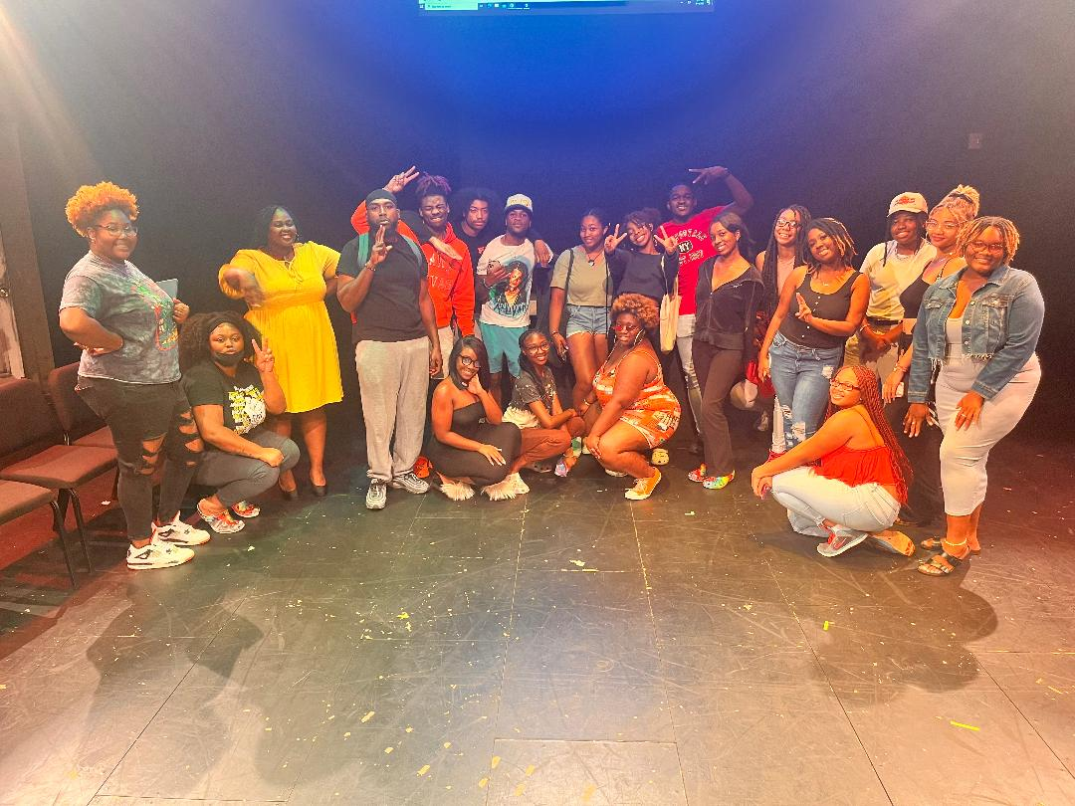
Albany State University Theatre Ensemble
Alias: Theatre Ensemble
Chartered at ASU: 1970
Current President: C'Aira Merckson
Current Advisor (s): Ta'Varis Wilson
Mission: We, the members of The Albany State University Theatre Ensemble, a student organization of the Albany State University (hereafter referred to as ASU Theatre Ensemble) are devoted to the promotion and production of theatre on campus through the forum of musical and non-musical productions.
Signature Events: Single's Drip- A Valentines Day event meant to celebrate love in all relationships. Love of self, friends, and partners. This is an event where everyone is welcome.
Membership Requirements: Have a passion for theatre!
Keep Up With Us: On Instagram @albanystatetheatre
Registered Student Organizations

Slide 22
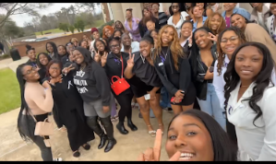
Collegiate Women of Empowerment
Alias: CWOE
Chartered at ASU: 2019
Current President:
Chanel Fairley
Current Advisor (s):
Uzell Williams
Mission: Through full participation, these young women will transition into fierce, bold, and acclaimed women; with unbreakable self-confidence, strength, and beauty. Additionally, this organization will work to provide community service and support to all those in need.
Signature Events:
Chill & Chat
Membership Requirements: Must be currently enrolled at Albany State University
Must possess a minimum of 2.0 GPA
Must be free from any university or court sanction
Must participate in a minimum of 9 hours of community service per semester
Keep Up With Us: Follow us on IG @asu_cwoe
Insert Org. Logo
Insert Group/Event Photo
Registered Student Organizations

Slide 23
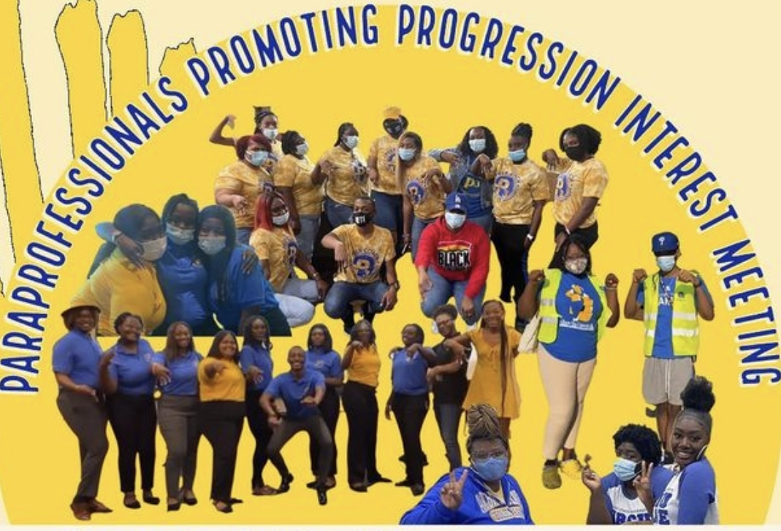
Student Organization Name: Paraprofessional Promoting Progression
Insert Org. Logo
Alias: P3
Chartered at ASU:1990
Current President: Antone Jenkins
Current Advisor (s): Dean Williams
Mission: Para
Signature events: FYE teacher assistants, campus champions
Membership Requirements: must have at least a 2.5 gpa, campus involvement
Keep Up With Us:
Insert Group/Event Photo
Registered Student Organizations

Slide 24
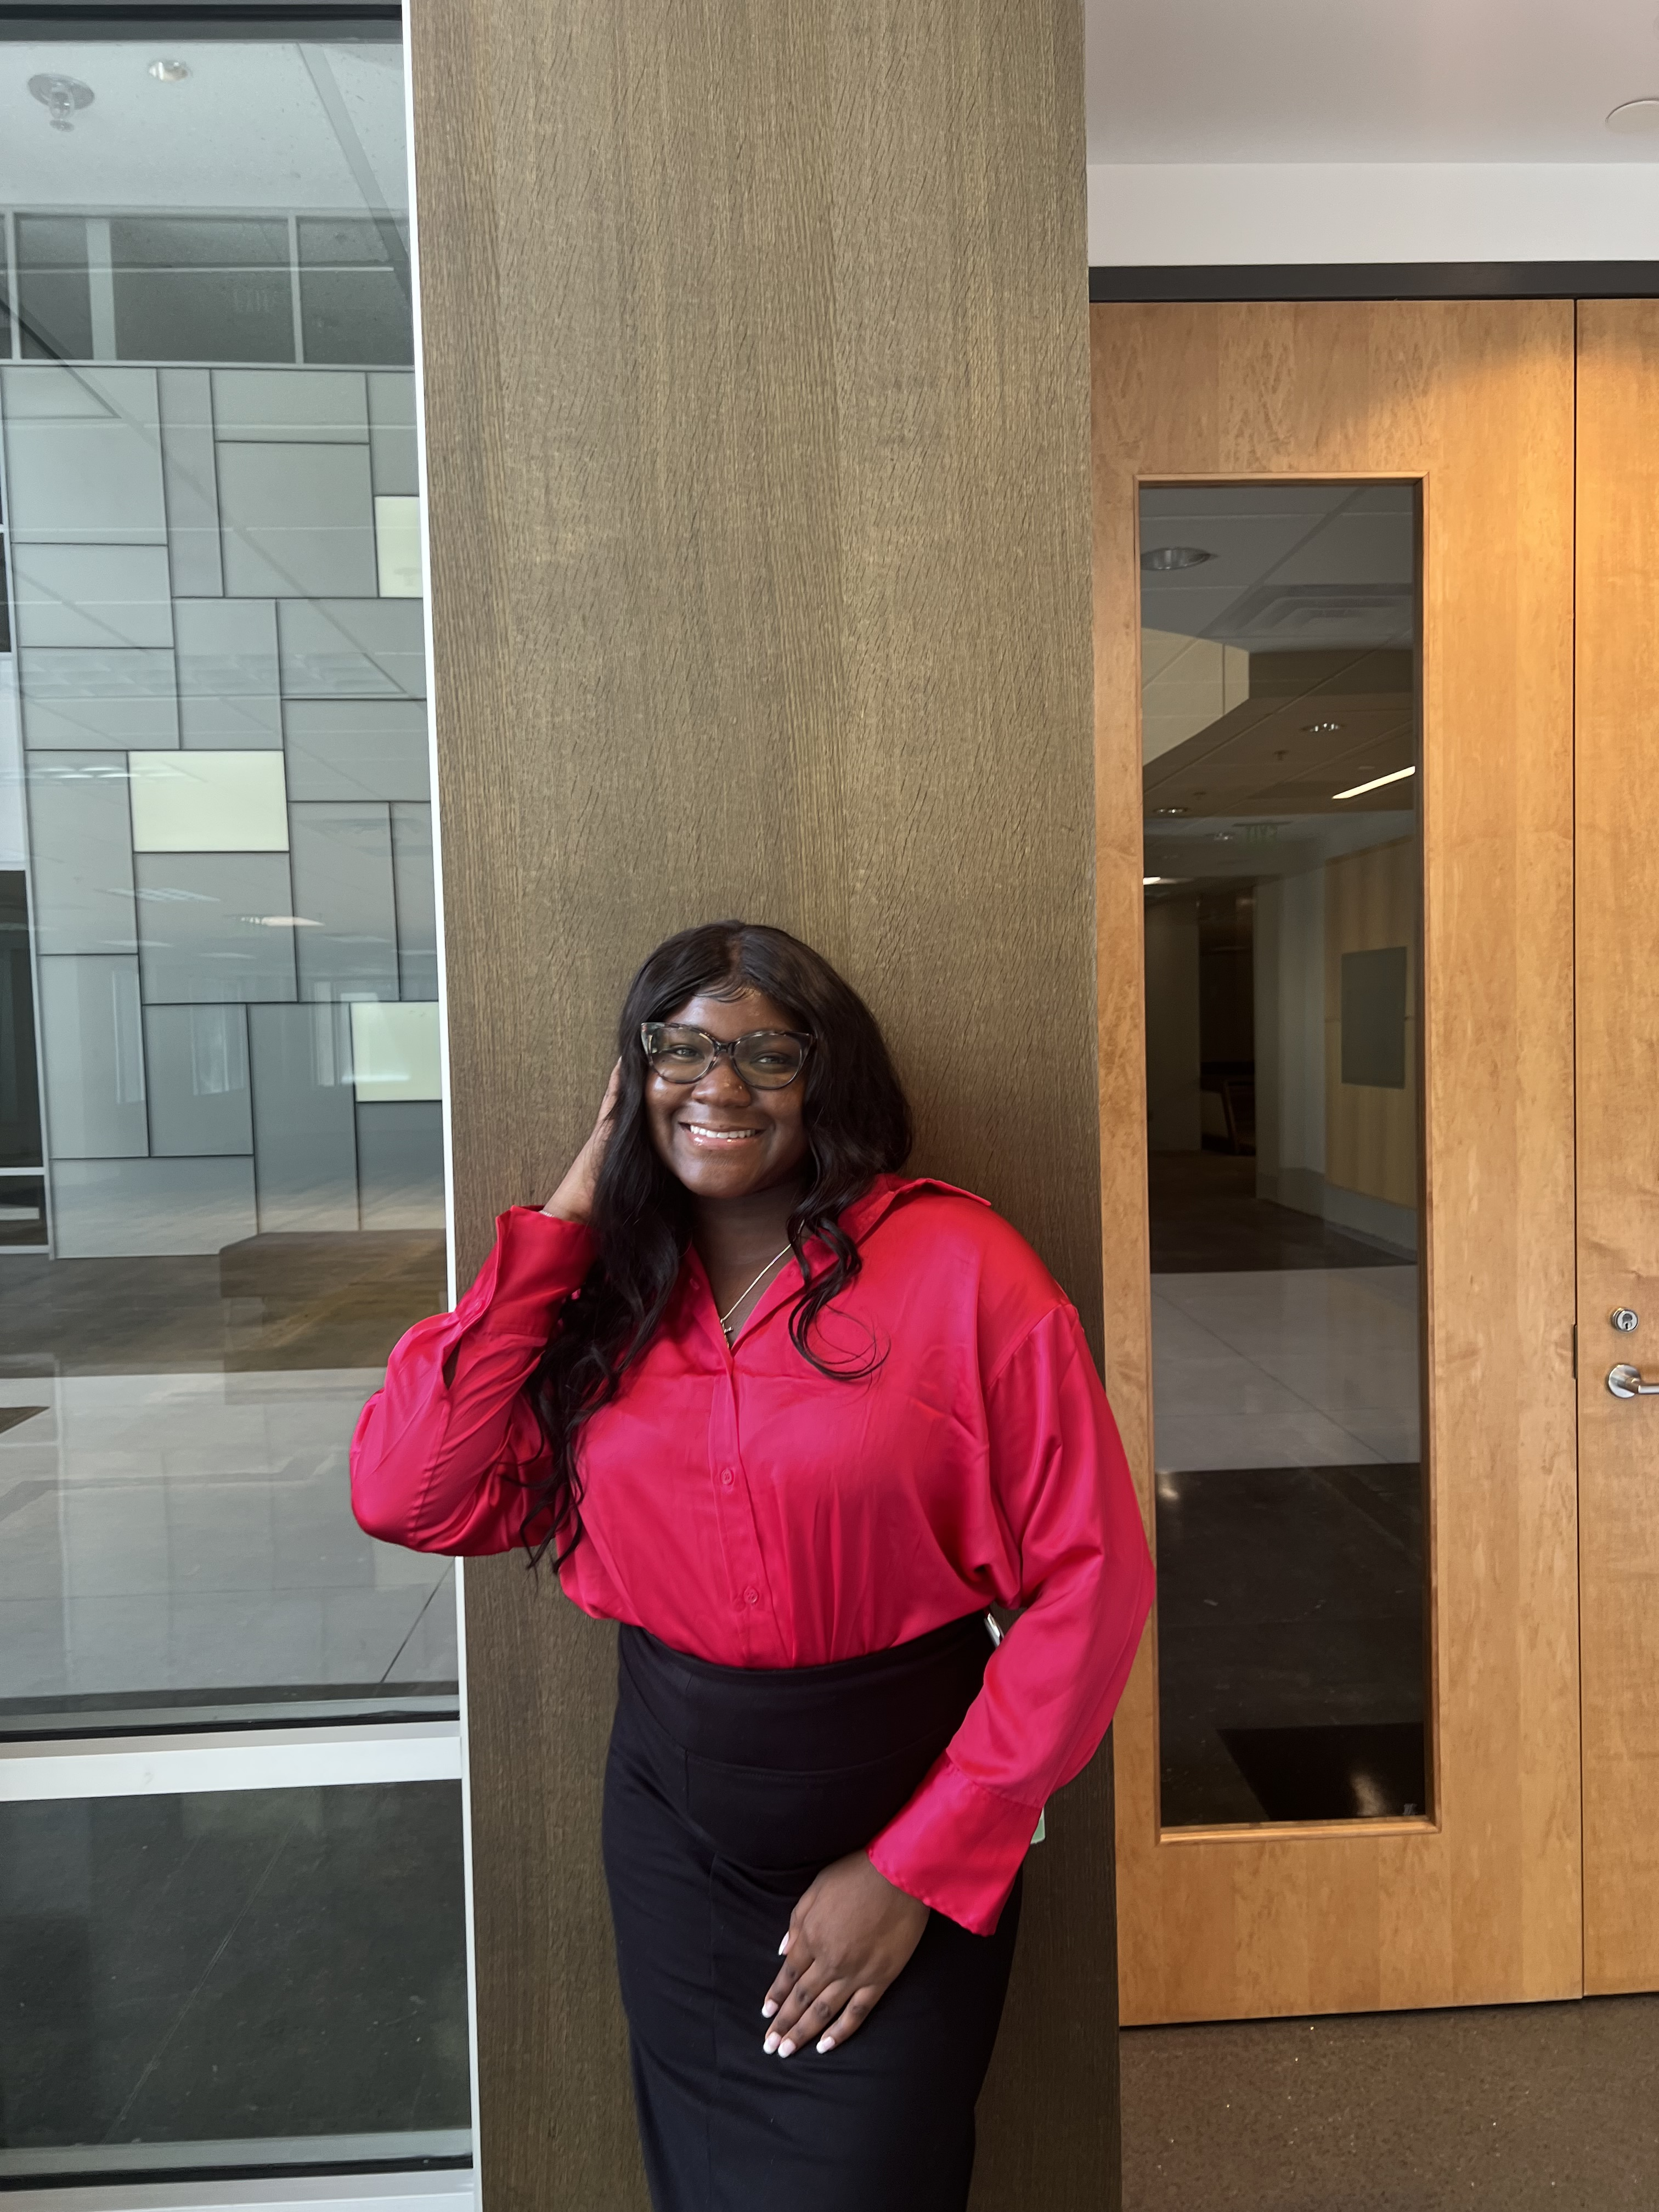
Women In Leadership
Alias: WIL or GNI
Chartered at ASU: Fall 2000
Current President: Courtney Bailey
Current Advisor (s): Dedra Williams, Venessa McKinney
Mission: Our mission is to champion the voices and experiences of marginalized women in South Georgia, nurturing their holistic development through advocacy, educational programs, and support services. We strive to create a community where all women feel empowered, valued, and encouraged to achieve their full potential.
Signature Events: Women's Rites of Passage Ceremony, Women's History Brunch, Girl Scouts Troop 40606
Membership Requirements: Identify as a woman
Keep Up With Us: @GNI1903
Registered Student Organizations

Slide 25
PHRESHLYFE
Alias: Phreshlyfe
Chartered at ASU: 2022
Current President: De’Montae
Current Advisor (s): Toderick Devoe
Mission: We as a organization want to show confidence and strength in the way we Model
Signature Events: End of the semester show
Membership Requirements: Gpa:2.5,campus involvement
Keep Up With Us: Follow us on Ig:
Phreshlyfe_asu
Insert Org. Logo
Insert Group/Event Photo
Registered Student Organizations

Slide 26
Council for LGBTQIA+ and Ally Student Syndicate
Insert Org. Logo
Alias: C.L.A.S.S
Chartered at ASU: August 2021
Current President: Kaitlyn Winn
Current Advisor (s): Dedra Williams, Venessa McKinney
Mission: To enrich the lives of queer people while seeking to broaden community transformation; encompassing issues of social and racial justice that LGBTQ people face on campus and in life.
Signature Events: Wellness Fair, HIV/AIDS Awareness, Black Pride Festival
Membership Requirements: There are no requirements
Keep Up With Us: @asu_c.l.a.s.s
Registered Student Organizations

Slide 27
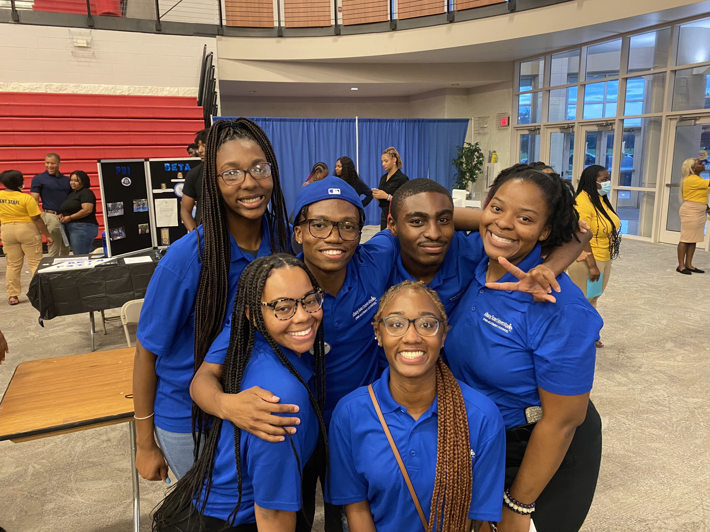
Pre-Alumni Council
Alias: PAC, ASU-PAC, ASU Pre Alumni Council, Albany State University Pre-Alumni Council
Chartered at ASU: October 2000
Current President: Jericho Robinson
Current Advisor (s): Joslyn DiPasalegne and Janet Puckett
Mission: To promote and enhance University Pride; build a culture of philanthropy to advance Albany State University and create opportunities to balance long term relationships with current students and Alumni.
Signature Events: Pre-Alumni council Annual PAC Week- This year we will be celebrating the 23rd anniversary of PAC and allow staff, students, and alumni to bond and have fun. Ice Cream social, PAC Movie night
Membership Requirements: Must be currently enrolled at Albany State University
Must possess a minimum of 2.8 GPA
Must be free from any university or court sanction
Keep Up With Us: Instagram @asuprealumni_
Registered Student Organizations

Slide 28
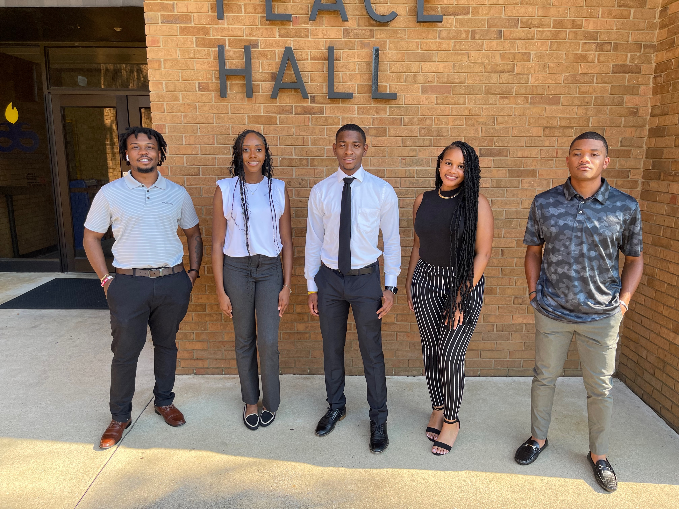
Marketing and Advertising Club
Alias: M&A Club
Chartered at ASU: 2022
Current President: Jazlyn Romer
Current Advisor (s): Edwin Odipo Nyanwala ,Imani Zackery Bennett ,
Victor Williams
Mission: At the ASU Marketing and Advertising Club, we are dedicated to fostering a dynamic community of aspiring marketers and creators who are passionate about transforming ideas into impactful designs. Our mission is to provide a platform where students can empower each other and strive to their fullest creative potential. Through leadership, workshops, seminars, and guest speaker panels.
Signature Events: Marketing and Advertising Week: This year for Marketing week will be centered around a movie theme, offering students the opportunity to delve into marketing, establish real-life connections, and participate in events such as the Pursuit of Business panel, Business After Hours, the Pandora workshop, and many more.
Membership Requirements: - Must be currently enrolled as a student.
- Must have a minimum GPA of 2.75
- Must be in good standing with the school.
- Attendance requirements include being present at a minimum of 2 meetings and attending or assisting in at least 2 club events
Keep Up With Us: Instagram : M_Aclub
Registered Student Organizations

Slide 29
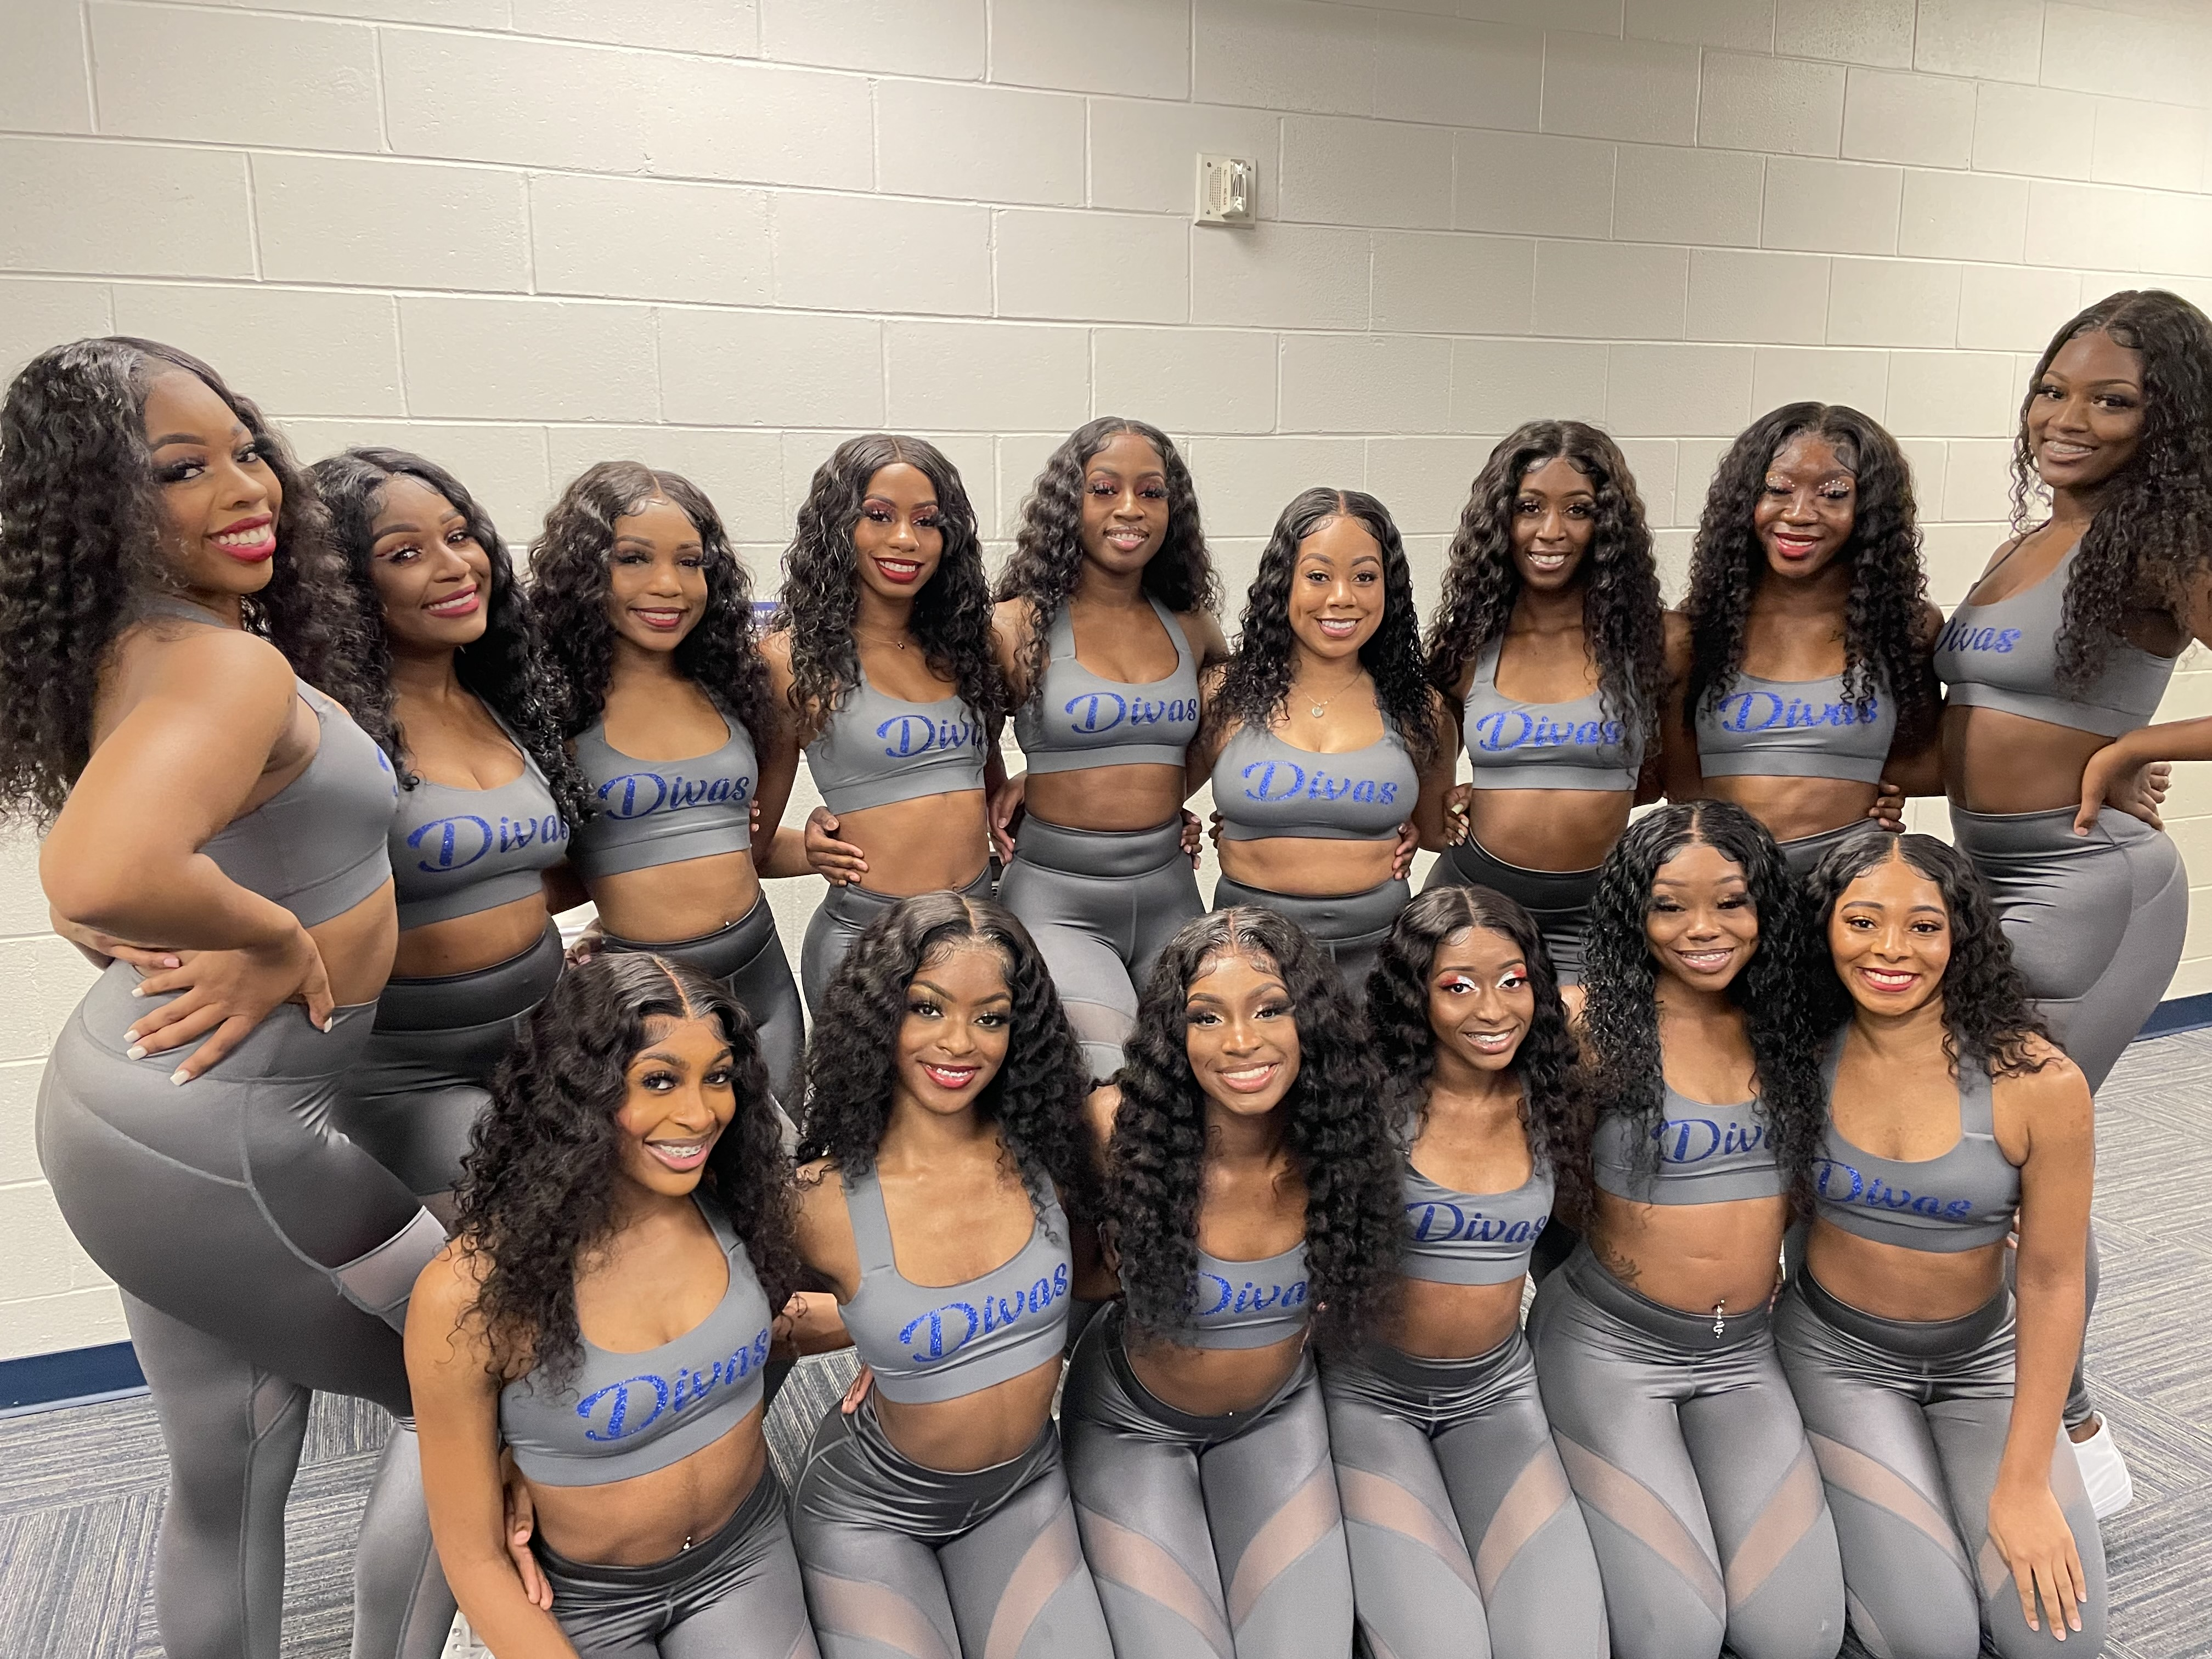
Platinum Divas
Alias: Divas
Chartered at ASU: 2000
Current President: Precious Evans & Priya Oyagha
Current Advisor (s): Quenton Matthews, Robert Smith
Mission: To provide a dance outlet to the ladies of Albany State University and to help express creativity and promote unity and strong friendships amongst the students. Also, to promote school spirit and provide entertainment to represent the school and community.
Signature Events: The Platinum Divas dance during basketball season. During fall semester we host dance clinics, showcases, study tables, community service events, and fundraise to give back to the community.
Membership Requirements: - Must be currently enrolled as a student.
- Must have a minimum GPA of 2.5
- Must be in good standing with the school.
- Tryout requirements includes an interview and an open tryout where students will be taught a routine for the upcoming season 2023-2024
Keep Up With Us: Instagram : @asuplatinumdivas
Twitter: @asuplatinumdiv1
Registered Student Organizations

Slide 30
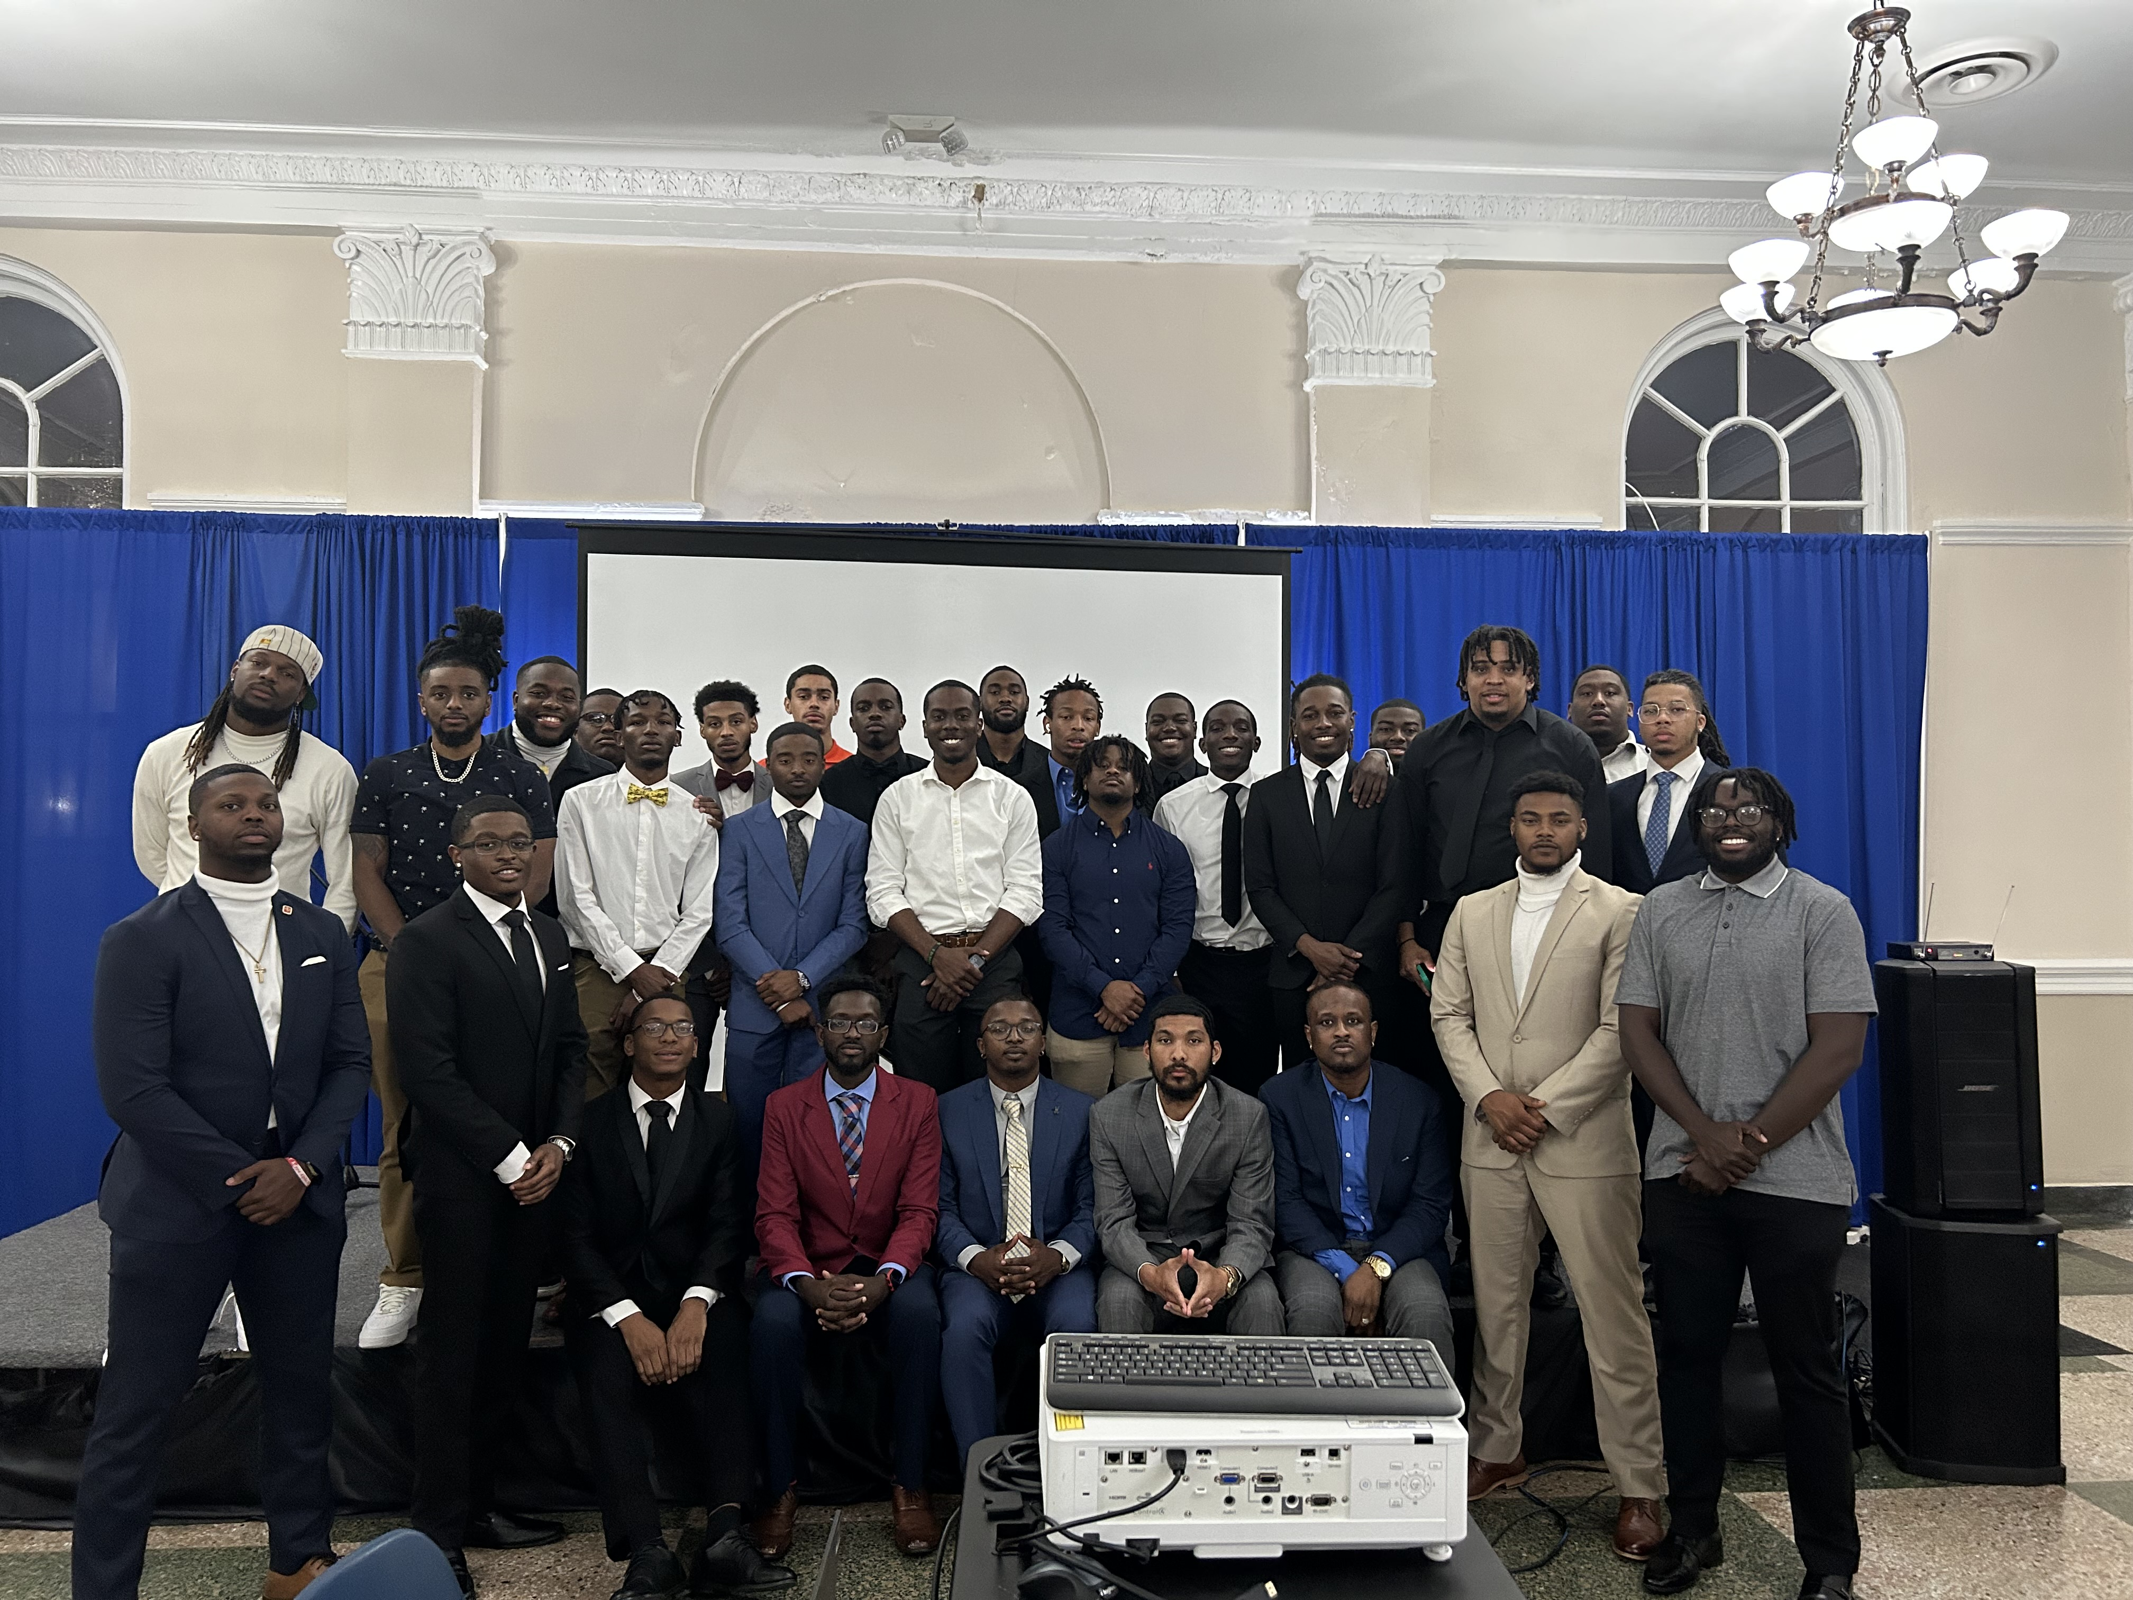
ASU K.I.N.G.S.
Alias: K.I.N.G.S.
Chartered at ASU: 2018
Current President: Olando Posey
Current Advisor (s): Brandon Willis
Mission: The purpose of this organization is to engage ASU students with educational, social, and service programs.
Signature Events: Man Cave Membership Requirements: Membership in the organization shall be open to currently enrolled Albany State University students.
Keep Up With Us: Instagram: @asu_k.i.n.g.s.
Insert Group/Event Photo
Registered Student Organizations

Slide 31
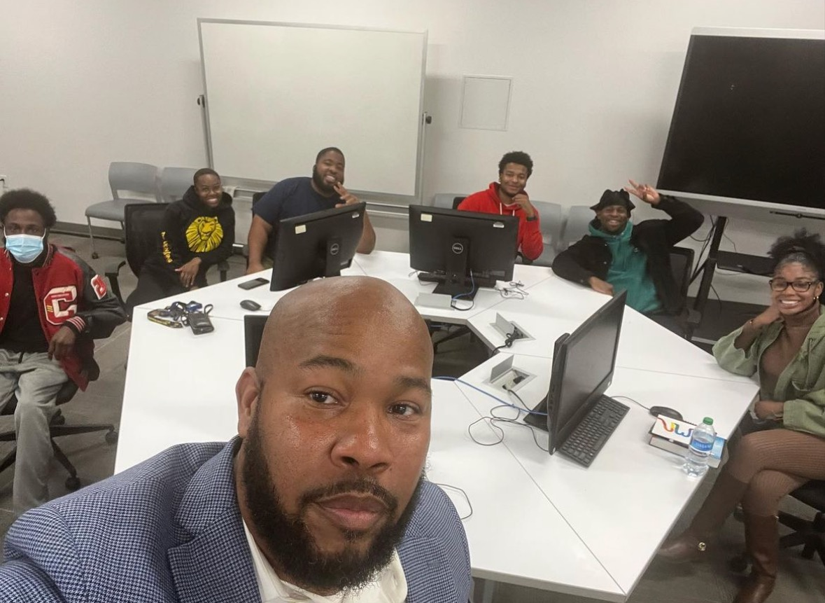
National Association for the Advancement of Colored People
Insert Org. Logo
Alias: NAACP
Chartered at ASU: N/A
Current President: Ahmad Moss
Current Advisor (s): Alexander Hawkins
Mission: Mission of the NAACP is to ensure the political, educational, social, and economic equality of rights of all persons.
Signature Events: Voter registration, Family Feud
Membership Requirements:
Active membership of the national NAACP
Keep Up With Us: @asunaacpchapter
Insert Group/Event Photo
Registered Student Organizations

Slide 32
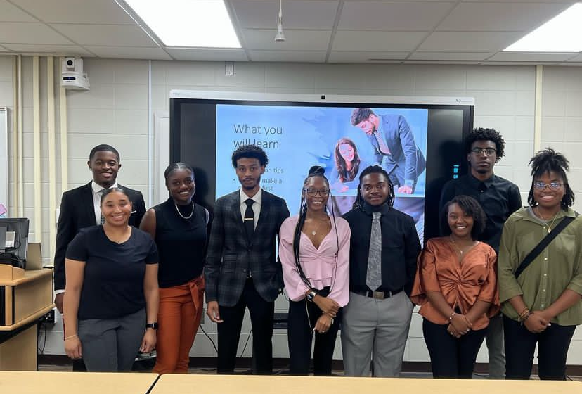
The Accounting Club
Alias: The Accounting Club
Chartered at ASU: Spring 2023
Current President: Ariana Woods
Current Advisor (s): Dr. Uzell Williams
Mission: To prepare undergraduate students for internships and job opportunities. To strengthen students' critical and analytical thinking skills, and to build a bond between business majors at ASU.
Signature Events: Internship Preparation, Scholarship Search Session, and
VITA Information Session
Membership Requirements: Members must maintain a 2.6 GPA, be enrolled as a full-time student at ASU, and must uphold professional standards and partake in leadership positions.
Keep Up With Us: asu_acctclub
Registered Student Organizations

Slide 33
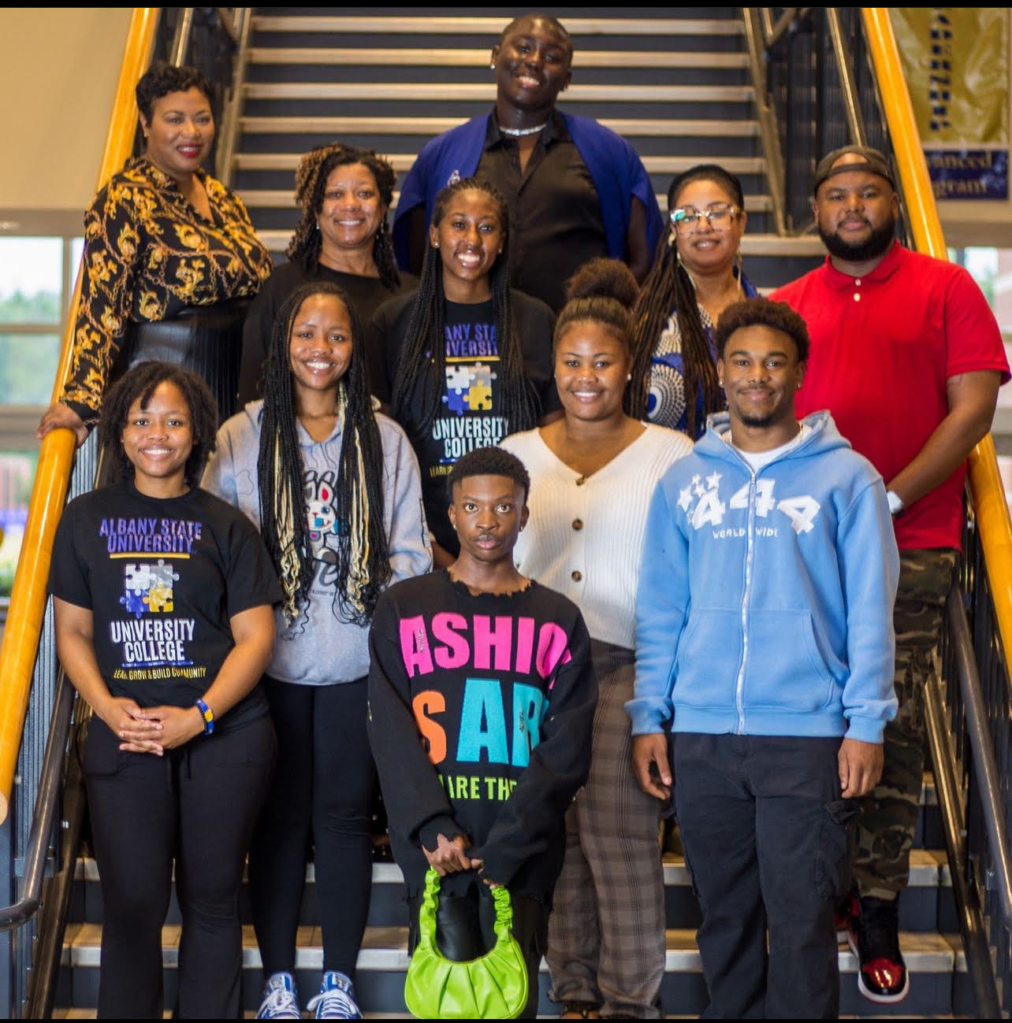
The Anchor Club
Alias: The AC
Chartered at ASU: Fall 2023
Current President:Rosalind LaFavor
Current Advisor (s): Dr. Steve Transou
Ms.Vanessa Anagbo-Dowetin
Mission: The Anchor Club at Albany State University is an umbrella organization that fosters success through the social and educational communities.AC strives to unite our leaders by cultivating cultural awareness and academic excellence. Our programs serve as a catalyst for academic, personal, and professional
Signature Events: Town Hall Meeting
Membership Requirements: Membership in this organization will not be based on discrimination based on race,handicap,age,gender,color,creed,religion,political persuasion,sexual orientation, or national origin.
Keep Up With Us:
Registered Student Organizations

Slide 34
Pre-Law Club
Current President: Shiloh Peters
Current Advisor: Dr Mayou
Alias: PLC
Chartered at ASU: 2021
Mission Statement: At Albany State University, Pre-Law Club’s mission is to provide resources, guidance, and opportunities for aspiring law professionals. We strive to create a platform for networking, skill development, and advocacy, empowering our members to become successful and make a positive impact within the community.
Membership Requirements:
Must be enrolled as a full time student
Cumulative 2.50 GPA
ALL MAJORS ARE WELCOMED!!
Signature Event: LSAT Prep, Mock Trials
KEEP UP WITH US!!!
Email: prelawclub2021@gmail.com
Instagram: albanystate_law

Slide 35
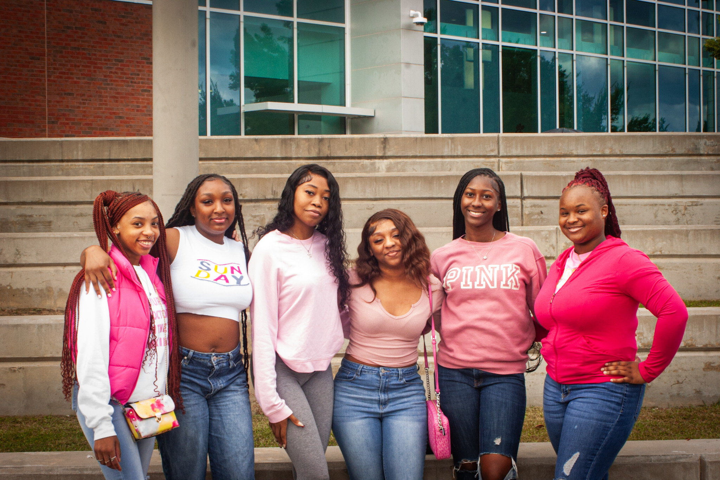
Women In Pre-Med
Alias: WIPM
Chartered at ASU: Spring 2024
Current Chapter Representative: Amaya Williams Current President: Tiffany Williams
Current Advisor (s): Dr. Anta’Sha Jones
Mission: Our mission is to support women of all racial backgrounds aspiring to pursue a degree in the healthcare field.
Signature Events: Study hall, Internship Review/Mock Interview, Health Professional Panel
Membership Requirements:
- Enrolled as a student at Albany State University
- Completion of membership application
- Must maintain a 2.5 GPA
Keep Up With Us: Instagram @albanystate.wipm
Registered Student Organizations

Slide 36
Media Arts Club
Alias: Media Arts Club
Chartered at ASU: Spring 2024
Current President: Dayton Alexander
Current Advisor: Kimberly McCullough
Mission: As the Media Arts Club we aim to bring students of different majors together to find a similar interest in media arts.
Signature events: ASU short film festival, Directing & Writing Workshop.
No membership requirements
Keep up with us: @Media Arts Club
Email: mediaartsclub1903@Gmail.com

