Slide 1




Preparing for the Next Chapter

Slide 2
TOPICS FOR DISCUSSION
USG Retirement Systems
When can I retire
Pre-65 Retirement
Post-65 Retirement
Benefits after retirement
Years of services with USG
Vacation and Sick leave-what happens

Slide 3
USG RETIREMENT SYSTEMS
In accordance with state law, the Board of Regents provides for the retirement of all eligible employees through the following:
Teachers Retirement System of Georgia (TRS)
The Employees’ Retirement System of Georgia (ERS).
The Regents’ Retirement Plan (which is also referred to as the Optional Retirement Plan of the University System of Georgia) (ORP). The exempt USG employees are eligible to enroll in ORP or TRS.
Note: The only USG employees eligible for ERS are those who have vested in ERS prior to being hired by the USG and who elect, upon hire by the USG, to remain in ERS.

Slide 4
When Can I Retire?

Slide 5
When Can I Retire?
BOR POLICY 8.2.8.2
As of November 1, 2002, an employee must meet at least one of the following four criteria at the time of employment separation to be eligible for retirement benefits from the University System of Georgia (USG), regardless of the retirement plan selected.
An employee must have been employed by USG for the last ten years in a regular, benefited position and have attained age 60.
An employee must have at least 25 total years of benefited service established with a State of Georgia sponsored retirement plan, of which the last five years of employment must have been continuous and with the USG. An early pension benefit penalty will apply to an individual who elects to participate in TRS or ERS if he or she decides to retire with between 25 and 30 years of benefited service, prior to attaining age 60.
An employee must have at least 30 total years of benefited service established with a State of Georgia sponsored retirement plan, of which the last five years must have been continuous and with the USG
An employee must be deemed to be totally and permanently disabled, as documented through the receipt of disability benefits from Social Security or from TRS following ten years of continuous service to the USG in a regular, benefited position.

Slide 6
When Can I Retire?
BOR POLICY 8.2.8.4
A State of Georgia employee who transfers to the USG without a break in service shall be eligible to retire with Health and Life benefits provided that on the date of his or her separation of employment.
He or she has attained age 60 and has a minimum of ten years of service established with a State of Georgia sponsored retirement plan and the last 12 months of employment have been served with the USG.
He or she has a total of 25 years of service established with a State of Georgia sponsored retirement plan, regardless of age and the last 12 months of employment have been served with the USG.

Slide 7
When Can I Retire?
NOTE: You must be enrolled in a USG healthcare plan immediately before you retire. If you are not currently enrolled in a USG healthcare plan, you should enroll during Open Enrollment in the year prior to your retirement to be eligible to continue USG retiree healthcare benefits into retirement.

Slide 8
When Can I Retire?
In addition to your retirement benefits through the Teachers Retirement System of Georgia (TRS), Optional Retirement Plan (ORP), or Employee Retirement System (ERS), USG also provides healthcare, dental, vision and life insurance benefits in retirement, if you meet one of the conditions according to policy 8.2.8.2 or 8.2.8.4.

Slide 9
Retiring prior to age 65

Slide 10
Retiring prior to age 65
When you retire and are under age 65, both you and your covered dependents will automatically continue with the same coverage (USG healthcare, dental, vision) you had as an active employee, there are some exceptions supplemental life insurance policies.
                BlueChoice HMO-based on address. If you are enrolled in the HMO plan and decide to move out of the service area, you will default to the Comprehensive Care plan.
                Comprehensive Care
                Consumer Choice HSA
Upon retirement, your life insurance will be reduced to the retirement-allowed amounts. You may have the option to convert your active employee life insurance into an individual policy by paying premiums directly to MetLife. If you wish to opt out of coverage, please contact OneUSG Connect - Benefits.
Important: If you choose not to continue any of these plans into retirement or cancel coverage at any point, you will not be able to re-enroll, even in the event of a life event.
Note: If your spouse is age 65 or older, they must enroll in Medicare Parts A and B prior to your date of retirement and then enroll in healthcare coverage through Alight Retiree Health Solutions (ARHS).

Slide 11
Retiring at age 65 or older

Slide 12
Retiring at age 65 or older
As a Post-65 USG retiree, when you enroll in a healthcare plan (Medicare Supplement, Medicare Advantage), or pharmacy plan through Alight Retiree Health Solutions (ARHS), you receive an annual contribution to your Health Reimbursement Account (HRA). These funds can help cover Medicare Supplement premiums, vision/dental premiums, prescription drug costs, and other eligible healthcare expenses.
As long as you remain enrolled in a healthcare or pharmacy plan through ARHS, USG will continue contributing annually to your HRA for you and your Medicare-enrolled dependents.
Important: If your coverage with ARHS is discontinued or dropped, you will no longer be eligible for HRA funding. In order to remain eligible for this contribution, you must remain continuously enrolled in a Medicare Supplement, Medicare Advantage, or Medicare Prescription Drug Plan through ARHS.
If you retire mid-year, your first HRA contribution will be prorated based on the date you enroll in an eligible Supplemental health plan with ARHS.
If you had USG Dental, Vision, or Life Insurance as an active employee, you can continue these benefits into retirement.
2024 Annual Contribution
For USG current USG retirees, the University System of Georgia will contribute up to $2,640 annually to your HRA for both you and your Medicare-enrolled spouse. USG will determine and communicate the annual contribution each fall.

Slide 13
Retiring at age 65 or older
Your USG retiree healthcare benefit is an annual contribution to a Health Reimbursement Account (HRA) that can help you pay for your Medicare Part B premium, supplemental healthcare premiums, and other qualified out-of-pocket healthcare, dental, and vision expenses.
If you are age 65 or older when your retire, you must enroll in Medicare Parts A and B. As a retiree, Medicare will become your primary healthcare coverage.
When you first become eligible, you must enroll in at least one supplemental plan (Medicare Supplement, Medicare Advantage, or Prescription Drug Plan) through Alight Retiree Health Solutions (ARHS) to receive annual funding to your HRA for both you and your enrolled spouse.
You must have continuous USG retiree healthcare coverage and you must remain enrolled in at least one plan through the exchange to remain eligible for the HRA contribution. If you have a break in coverage or drop coverage with the ARHS, you will no longer be eligible for the HRA funding.
90 days before you turn age 65, you’ll receive a Medicare Enrollment Kit so you may enroll in Medicare Parts A and B. You will also receive an appointment letter from Alight Retiree Health Solutions asking you to confirm an appointment with an advisor.

Slide 14
Retiring at age 65 or older
The Alight Retiree Health Solutions will:
Help you understand the various components of Medicare
Provide access to a variety of Medicare (Medicare Advantage, Medicare Supplement, Prescription Drug) plans that cover you wherever you are located
Provide unbiased guidance and help with evaluating your options, comparing plans that fit your needs and budget, and enrolling in coverage
Continued to assist you after you enroll and as your needs change
Help you understand how to utilize your Health Reimbursement Account (HRA)
Note: If you are a post-65 retiree and you drop or cancel coverage purchased through Alight Retiree Health Solution, your pre-65 dependent will no longer be covered under the USG healthcare plan.

Slide 15
benefits transition
AFTER RETIREMENT

Slide 16
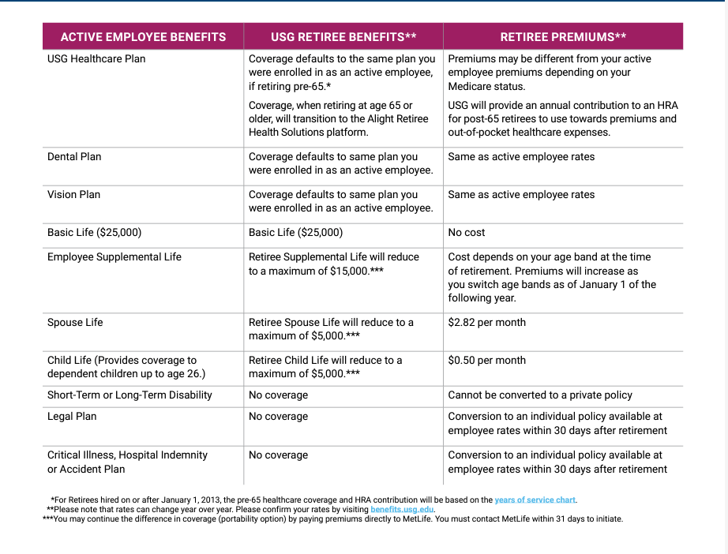
benefits transition

Slide 17
PAYING FOR BENEFITS

Slide 18
Retiring PRIOR TO age 65 or older:
Paying for retiree benefits
You must enroll in direct debit to ensure benefit payments are paid in full and made on time, so coverage is not interrupted. Per USG policy, you must pay premiums by automatic direct debit from a checking or savings account.
  To set up an automatic direct debit, call 844-587-4236 or online at OneUSG Connect - Benefits.
  Your payment will be due on the first of each month for the current month of coverage.
  When you initially retire, your next bill will show as past due. The bill will outline when your payment must be received to avoid the cancellation of your coverage. DO NOT WAIT UNTIL THEY SEND A BILL. MAKE YOUR PAYMENT BY THE 1ST. PLEASE CALL USG Benefits SO THAT YOU DO NOT APPEAR ON THEIR CANCELLATION LIST.
  If your coverage is canceled due to non-payment, your coverage will be canceled back to the last day of the month in which premiums were paid in full. If your retiree benefits are canceled for nonpayment, you will not be allowed to enroll in USG healthcare insurance at a later date.

Slide 19
Retiring at age 65 or older:
Paying for retiree benefits
USG Retiree Healthcare: You will pay your monthly healthcare premium directly to the carrier selected through ARHS and you will use your Health Reimbursement Account (HRA) to help cover expenses related to being enrolled in Medicare and/or a supplemental plan.
  Join a quarterly HRA education session to learn how to make the most of your annual HRA contributions.
USG dental, vision and life insurance: You must enroll in direct debit to ensure benefit payments are paid in full and made on time, so coverage is not interrupted. Per USG policy, you must pay premiums by automatic direct debit from a checking or savings account.
  To set up an automatic direct debit, call 844-587-4236 or online at OneUSG Connect - Benefits.
  Your payment will be due on the first of each month for the current month of coverage.
  When you initially retire, your next bill will show as past due. The bill will outline when your payment must be received to avoid the cancellation of your coverage. DO NOT WAIT UNTIL THEY SEND A BILL. MAKE YOUR PAYMENT BY THE 1ST. PLEASE CALL USG Benefits SO THAT YOU DO NOT APPEAR ON THEIR CANCELLATION LIST.
  If your coverage is canceled due to non-payment, your coverage will be canceled back to the last day of the month in which premiums were paid in full. If your retiree benefits are canceled for nonpayment, you will not be allowed to enroll in USG healthcare insurance at a later date.

Slide 20
YEARS OF SERVICE

Slide 21
YEARS OF SERVICE CHART
Employees hired on or after January 1, 2013, who retire after January 1, 2023, are subject to the Years of Service policy at the time of retirement. The years of service chart applies to:
Pre-65 retirees enrolled in a USG Healthcare plan-applies to the monthly employer contribution to your healthcare plan premium.
Retirees 65 and older enrolled in a supplemental healthcare or pharmacy plan through Alight Retiree Health Solutions. Will receive a percentage of $2,640 up to 100%.

Slide 22
YEARS OF SERVICE CHART
Retirees enrolled in USG Retiree Benefits | USG’s contribution
30 or more years of service | 100% of employer contribution
29 | 97%
28 | 94%
27 | 91%
26 | 89%
25 | 86%
24 | 81%
23 | 77%
22 | 73%
21 | 69%
20 | 64%
19 | 60%
18 | 56%
17 | 51%
16 | 47%
15 | 43%
14 | 39%
13 | 34%
12 | 30%
11 | 26%
10 | 21%
Fewer than 10 years | 0%
USG contributions towards retiree healthcare coverage will be prorated based on years of service with USG or the State of Georgia.

Slide 23
ADDITIONAL INFORMATION

Slide 24
Vacation and Sick Leave
If applicable, an employee maybe compensated for up to 360 hours of unused vacation time.
This will be received as a pay out by the next pay period after you receive your last USG paycheck.
As discussed earlier, if you are TRS retiree, unused sick leave hours can be applied towards retirement. Contact TRS for more information.
If you are under ORP, unused sick leave hours will not count toward the retirement balance.

Slide 25
Contact information
Contact oneusgconnect.usg.edu or contact the OneUSG Connect - Benefits Call Center at 1-844-5-USGBEN
(1-844-587-4236) for the following:
Questions about your USG retiree healthcare(Pre-65), dental, vision, life insurance or survivor benefits
Filing a death claim
Adding a spouse through a qualifying life event
To update your mailing or email address
To enroll in direct debit

Slide 26
Contact information
Contact Alight Retiree Health Solutions (ARHS)(65 and older health care premiums) at retiree.alight.com/usg or call 1-866-212-5052 Monday-Friday 9AM to 9PM for the following:
Questions about your HRA balance, funding or requests for HRA reimbursement
To enroll or make changes to your coverage through ARHS

Slide 27
Suggestions
Contact the Social Security Administration, if applicable at https://www.ssa.gov/ for questions you may have concerning retirement and their benefits.
Contact TIAA, Fidelity or Corebridge if you are interested in retirement information for ORP as well if you have monies in a 403(b) and/or 457(b)
Fidelity Investments netbenefits.com/usg 800-343-0860
TIAA TIAA.org/usg 844-230-7524
Corebridge Financial usg.corebridgefinancial.com 800-448-2542
Contact TRS at Teachers Retirement System of Georgia – TRSGA or I’m Ready to Retire | Teachers Retirement System of Georgia – TRSGA for questions about their retirement. You will need access to your account to begin the process and generate an estimate.

Slide 28
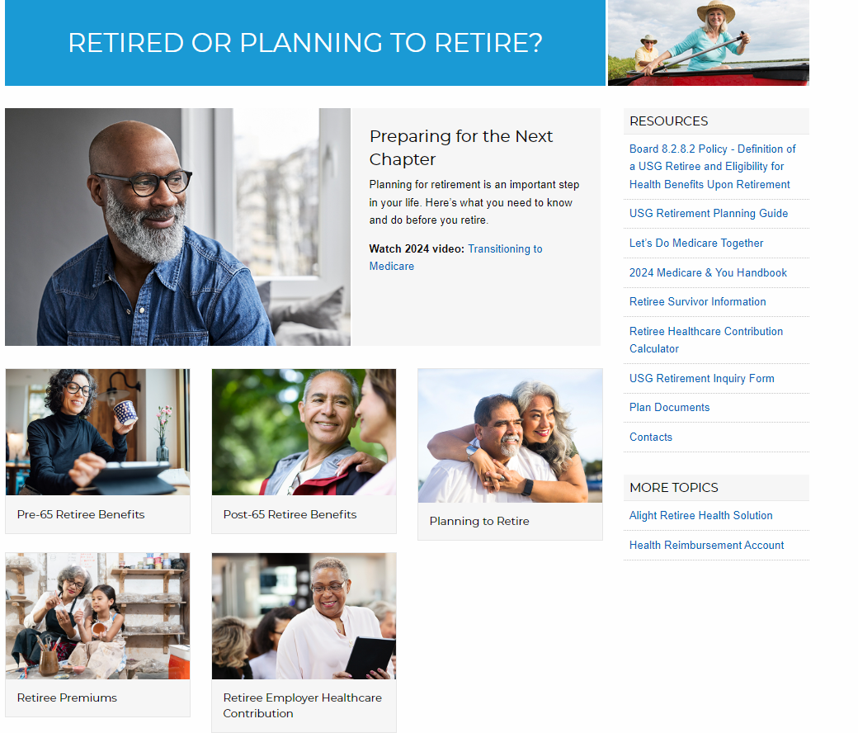
Suggestions
Visit https://benefits.usg.edu/benefits-resources/planning-for-retirement for more information on USG retirement.

Slide 29
THE END

