Slide 1
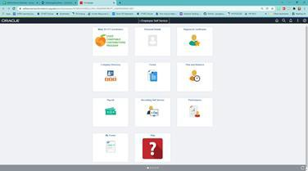
OneUSG ePerformance Overview

Slide 2
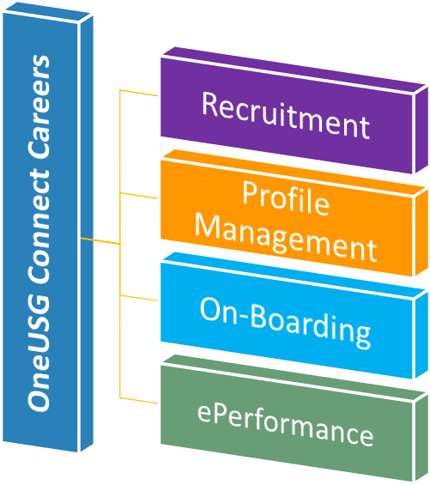
What is Careers?
‘Careers’ is an umbrella term representing the conglomeration of job openings, applications, employee on-boarding, and employee performance reviews
Add Division Name Here

Slide 3
What is ePerformance?
Electronic performance evaluations within OneUSG Connect.
Human Resources

Slide 4
No more shuffling paper
What’s in it for
me?
Access to your historical evaluation documents
Review of document by a level up from your supervisor
Human Resources

Slide 5
Overview of Process
Manager Defines Criteria
Self Evaluation
Manager Evaluation
Manager Defines Criteria
Managers will enter the goals set on last year (refer to last year’s goal setting section on the paper evaluation). Managers will also delete any job duties that no longer apply (note - duties cannot be added).
Employee will complete the self-evaluation. The self evaluation is an exact copy of what the manager will complete.
Manager completes the evaluation and submits it for approval to the next level up.
Human Resources

Slide 6
Overview of Process
4 - Submit to Employee
5 - Employee Acknowledgement
6 - Manager Submits/Completes
Manager meets with the employee to review the evaluation and submits it electronically for employee review. Once review is complete, manager submits to employee for acknowledgement.
Employee acknowledges evaluation and adds final comments.
Manager submits the completed evaluation electronically to HR within OneUSG.
Human Resources

Slide 7
Achievement of goals set last year
What will I be evaluated on?
Institutional Values
Job duties
Performance Factors/Competencies
Human Resources

Slide 8
Timeline
Training offered to introduce platform and process to campus
Managers to input goals (define criteria)
Early January
By February 4
January 18
February 25
Last day to submit evaluations to Human Resources
Evaluation documents available in OneUSG Connect.
Human Resources

Slide 9
Items to Note
Evaluations are based on “Reports to” structure in
OneUSG, not time approver
The type of evaluation is based on job code (Staff vs Leader)
Goals should be set for the upcoming year with begin and enddates.
Position description review - managers can access your position description in OneUSG. More directions will be provided to managers in January.
Human Resources

Slide 10
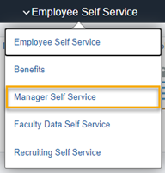
To Begin
Log into OneUSG Connect
Click on Employee Self-Service and then click on Manager-Service
Human Resources

Slide 11
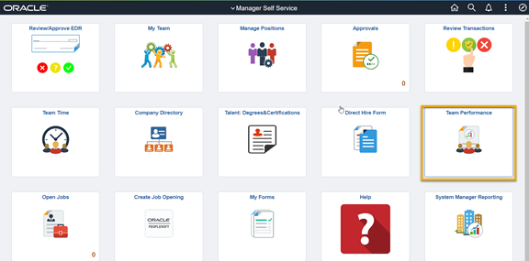
Continue
Click on the Team Performance Icon > Current Documents.
NOTE: Manager Self Service tile options may look different
Human Resources

Slide 12
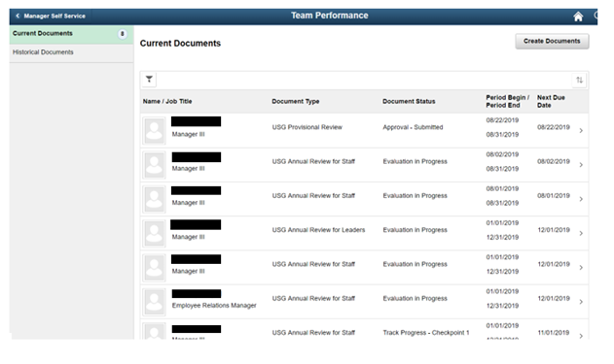
Continue
Click Current Documents on the top left
You will see the list of employees to review. Just select one to begin
Human Resources

Slide 13
Continue
Click on the Team Performance Icon > Current Documents.
NOTE: Manager Self Service tile options may look different
Human Resources

Slide 14
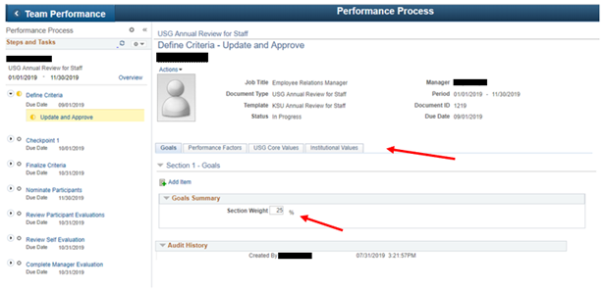
Continue
Click on each tab and compete the information.
All information on each tab must be completed for the review to progress.
Human Resources

Slide 15
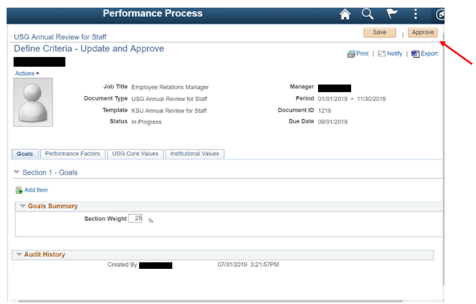
Continue
Be sure to save periodically or any time you leave the review.
Once the review has been completed, click Approved to move the it onto the next step
Human Resources

Slide 16
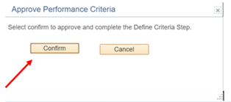
Continue
Select confirm to finish the criteria step.
You will see the stages on the left of the page.
Human Resources

Slide 17
Questions?
Human Resources

